Slide 1
WEEK 11 ASSIGNMENTS
KHADIJAH ADAM ROGO
FE/23/16472164

Slide 2
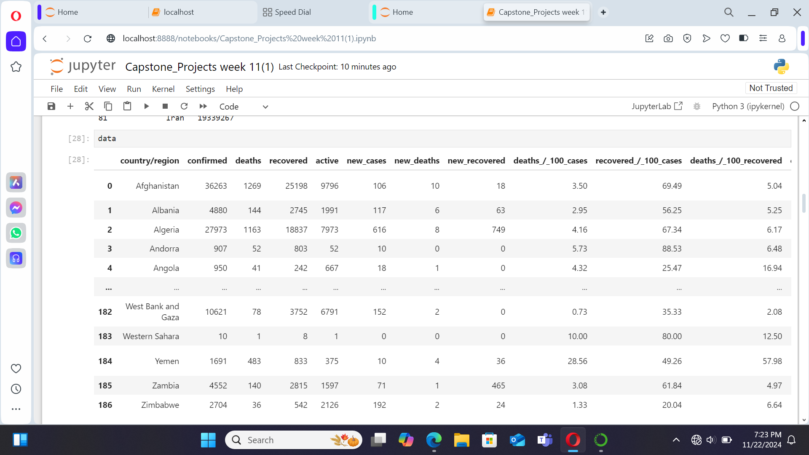


Slide 3
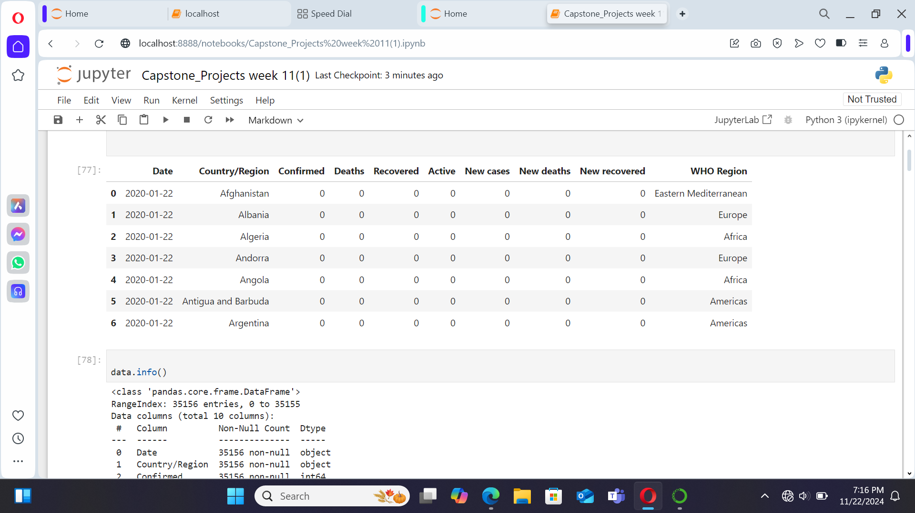

Slide 4
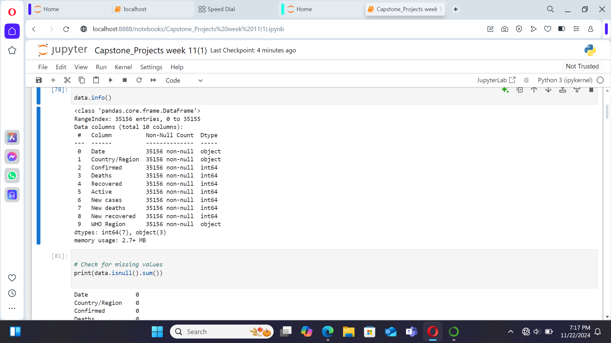

Slide 5
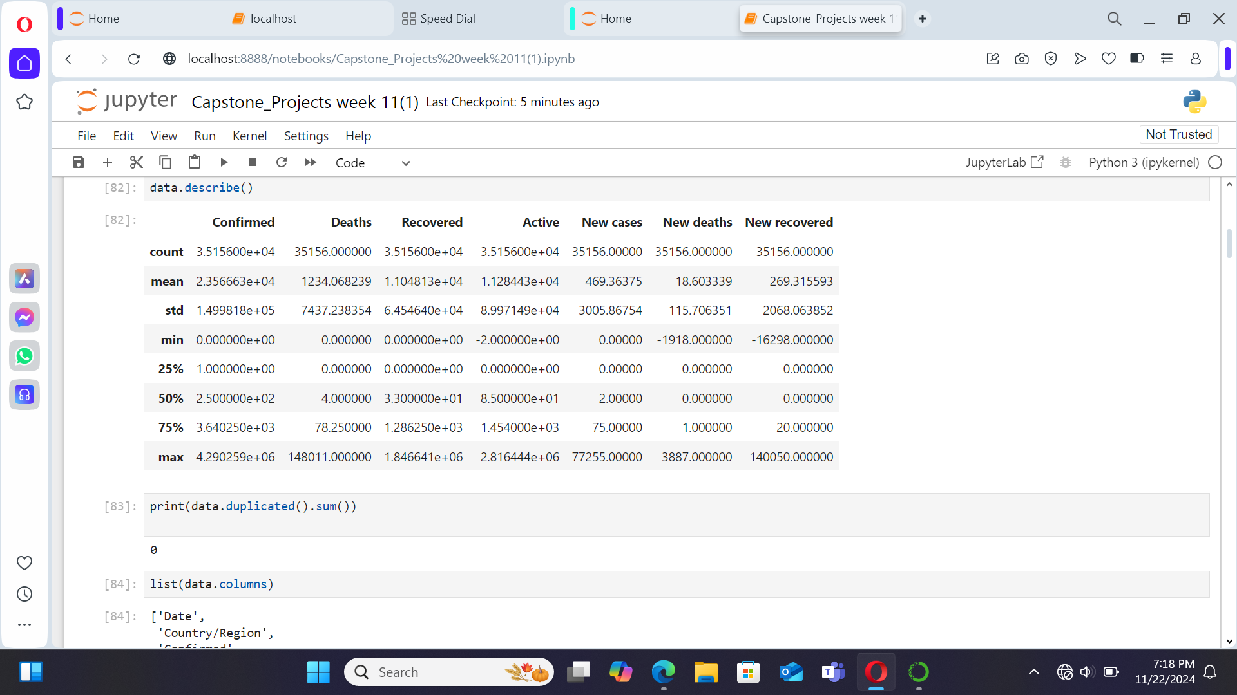

Slide 6
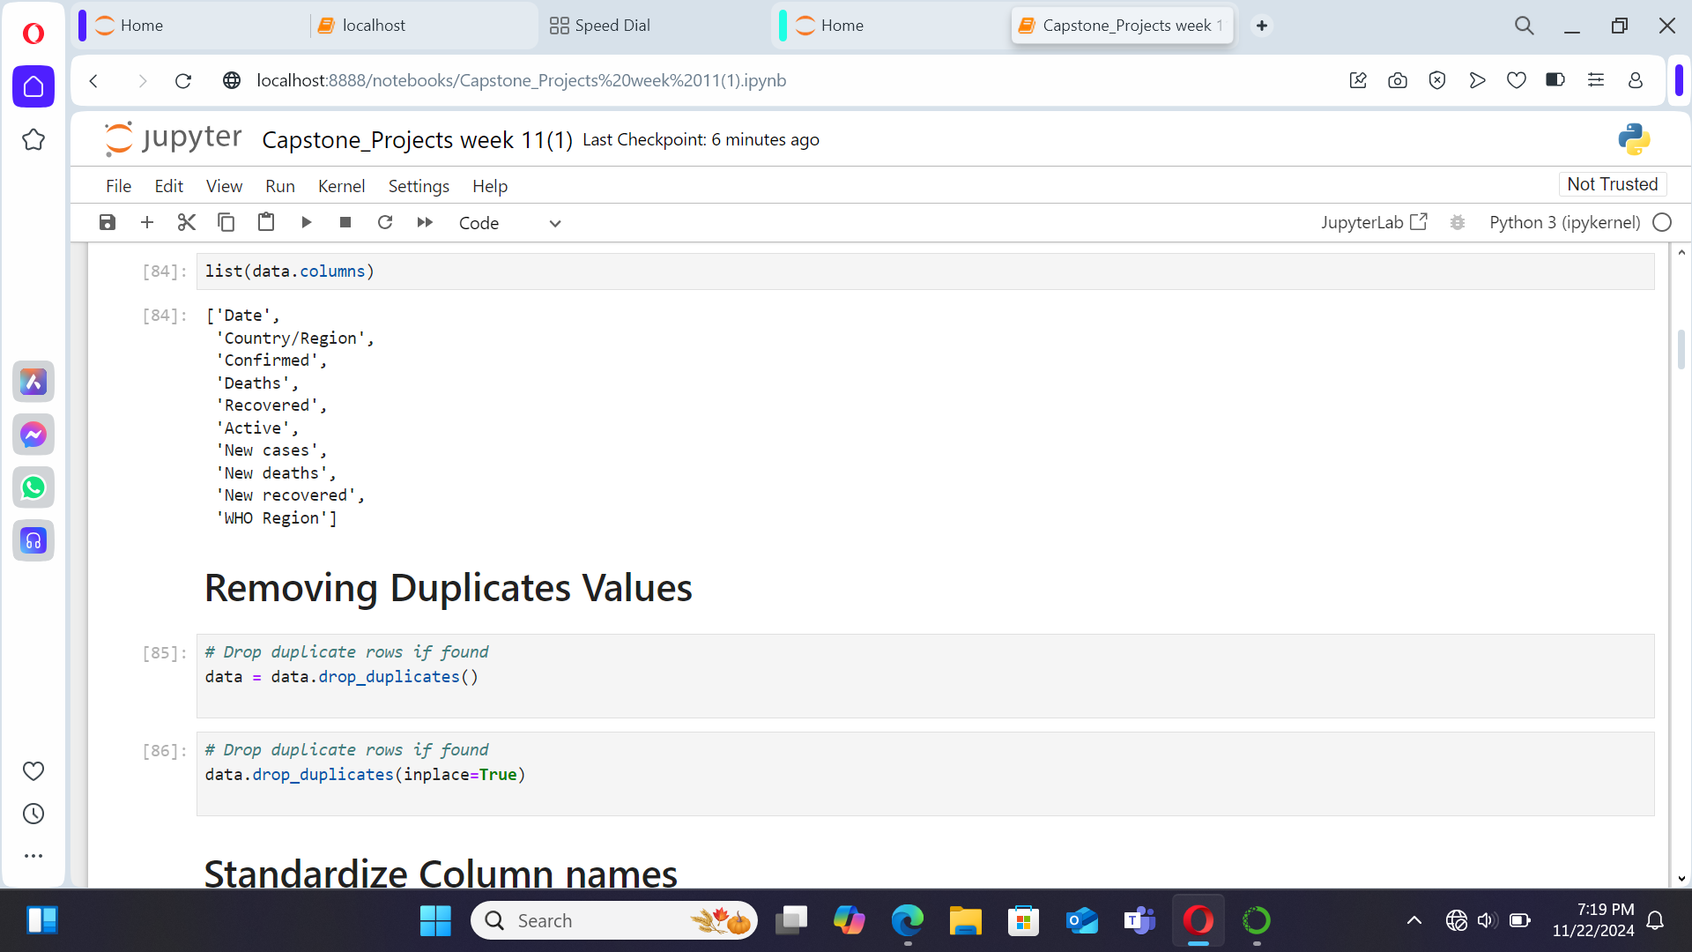

Slide 7
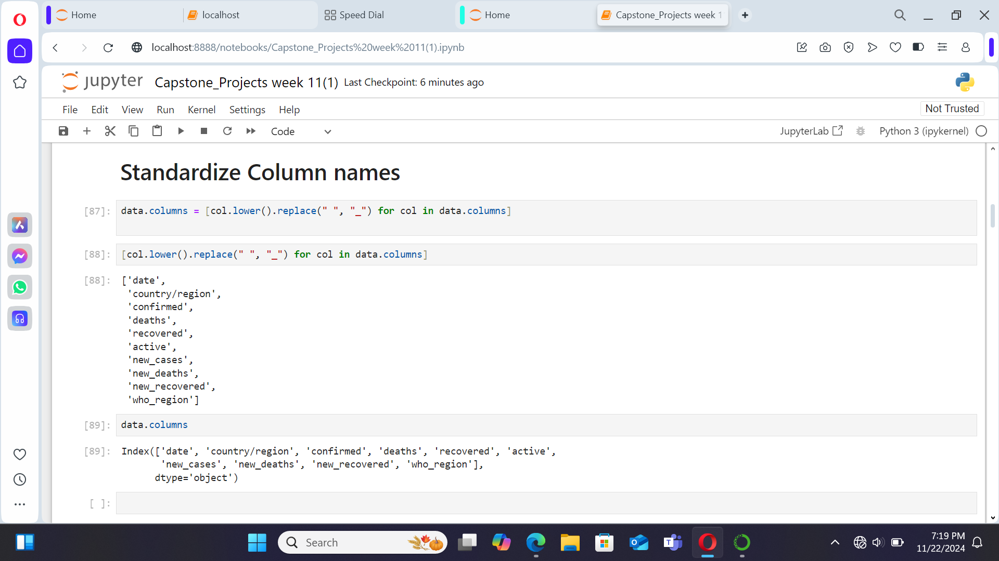

Slide 8
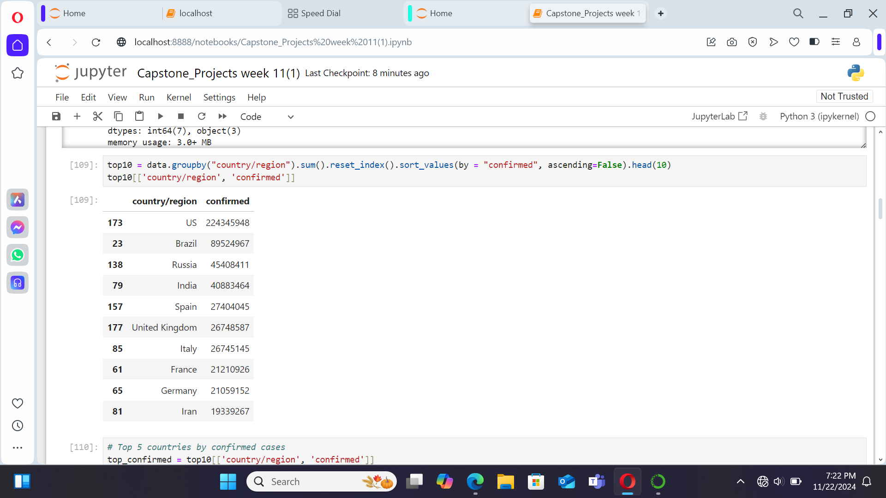

Slide 9
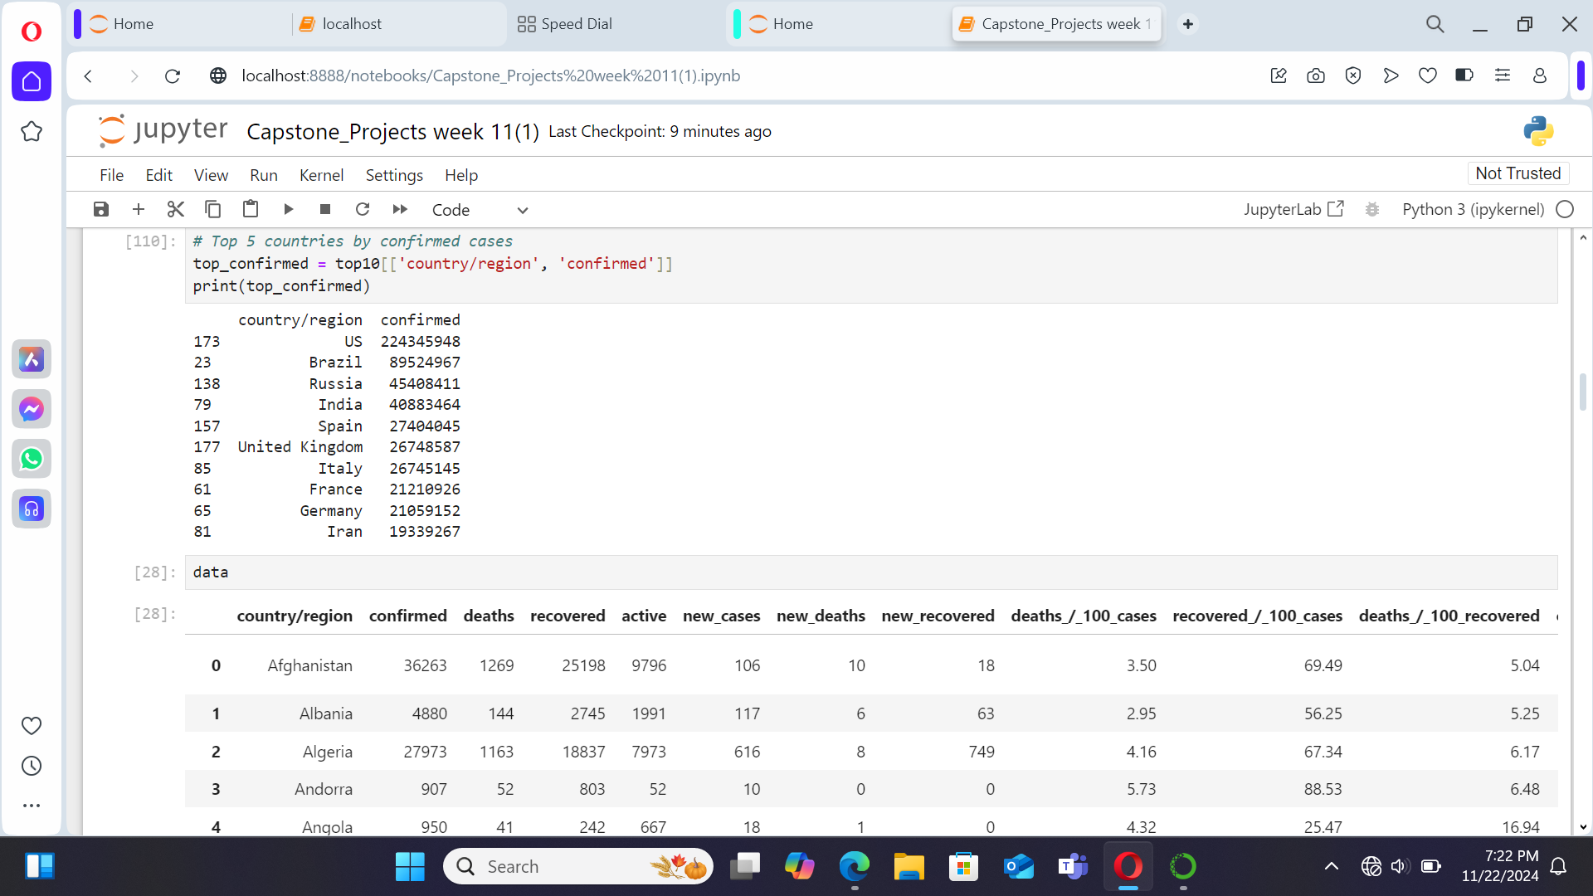

Slide 11
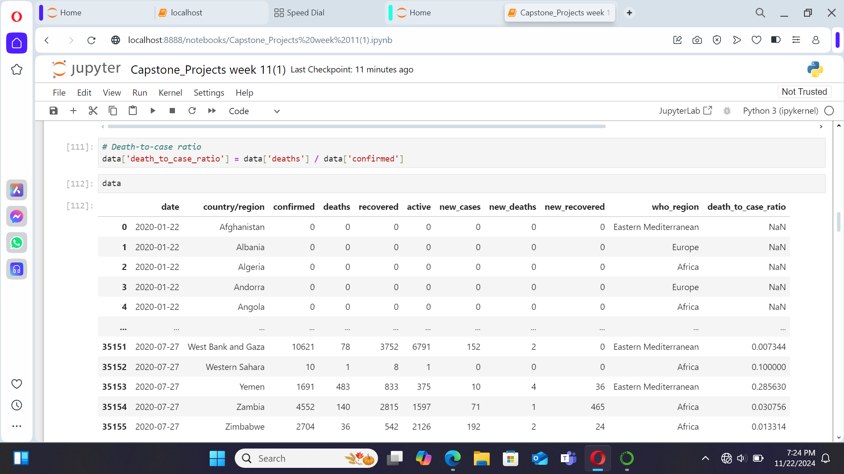

Slide 12
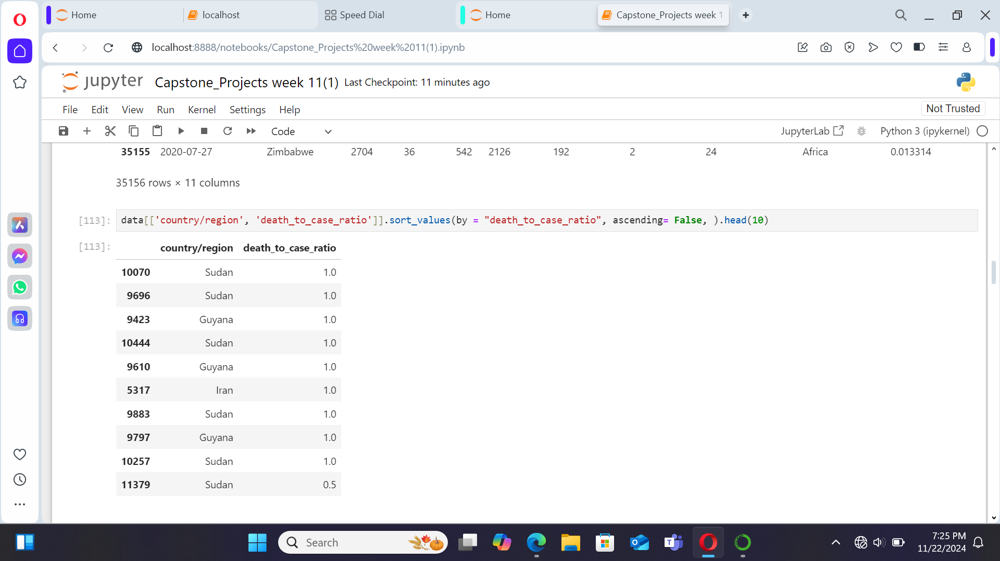

Slide 13
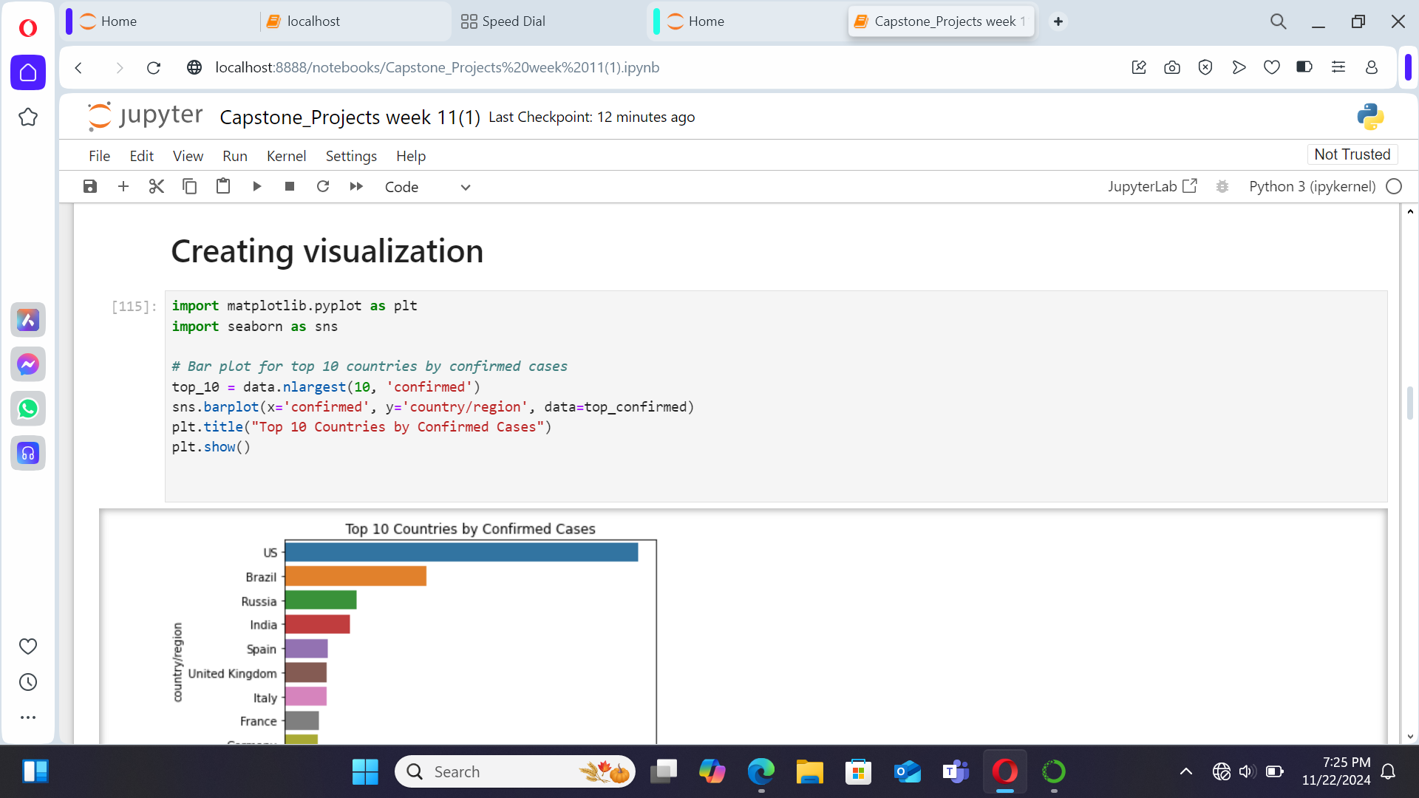

Slide 14
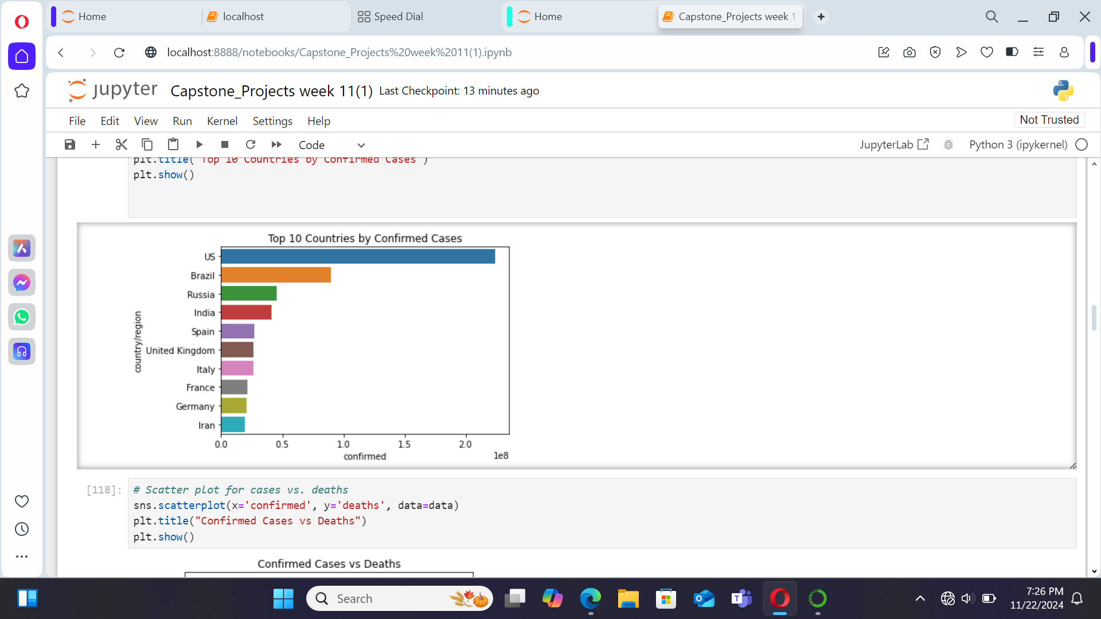

Slide 15
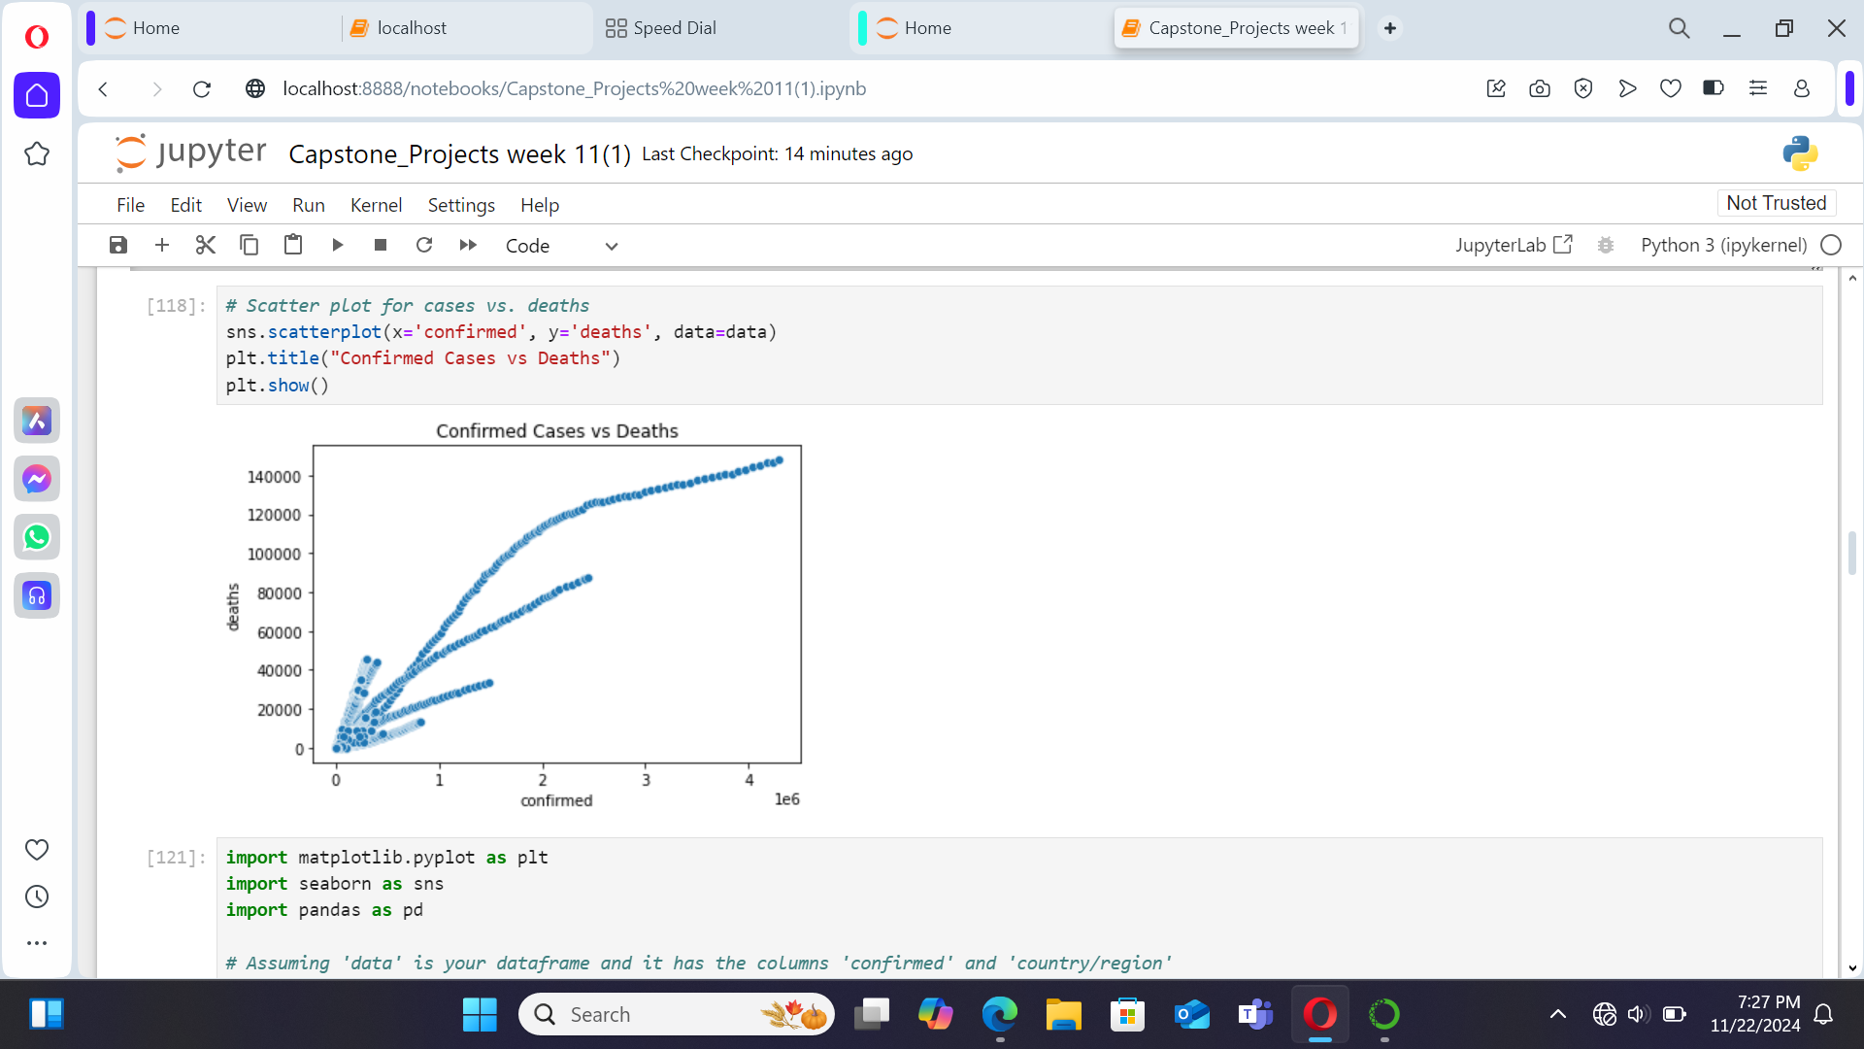

Slide 16
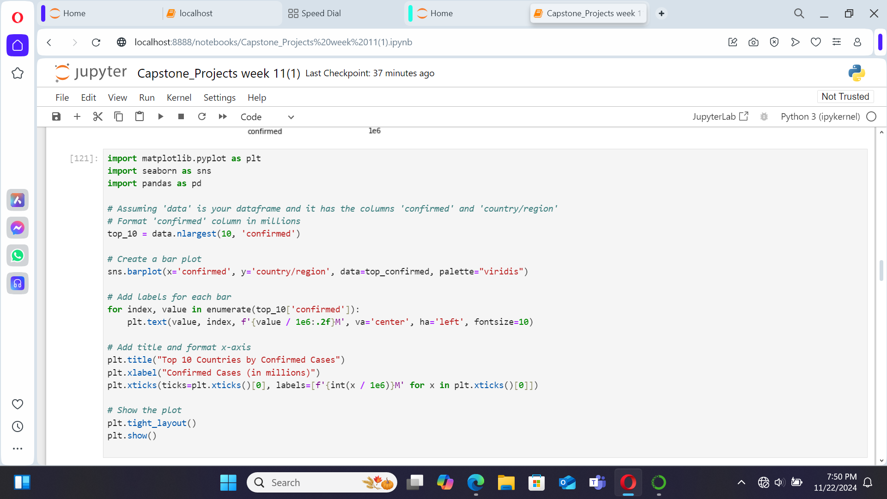

Slide 17
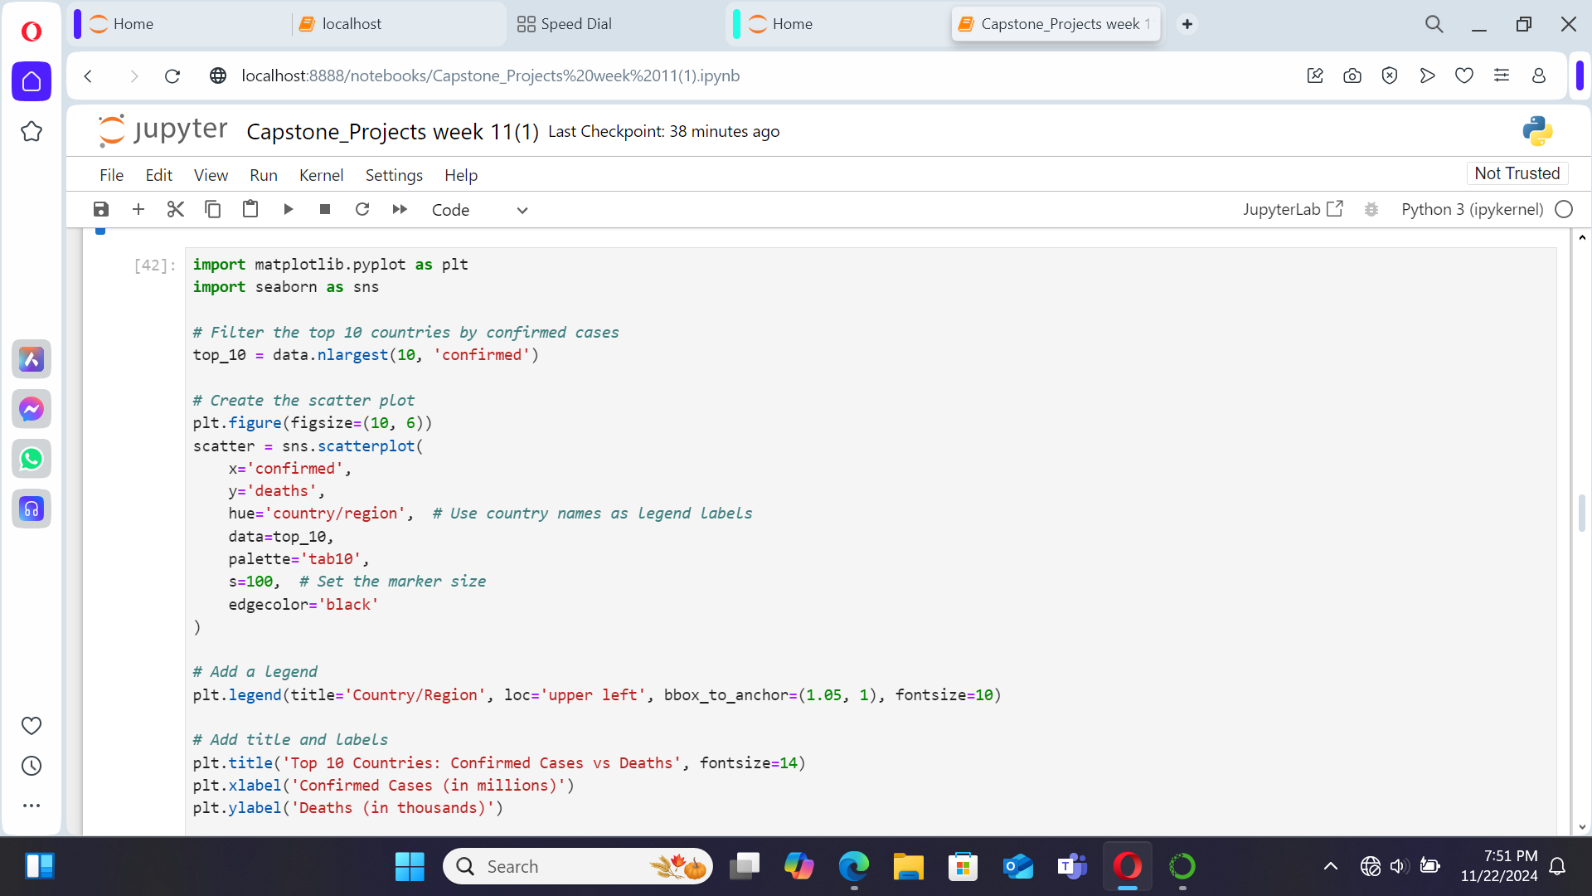

Slide 18
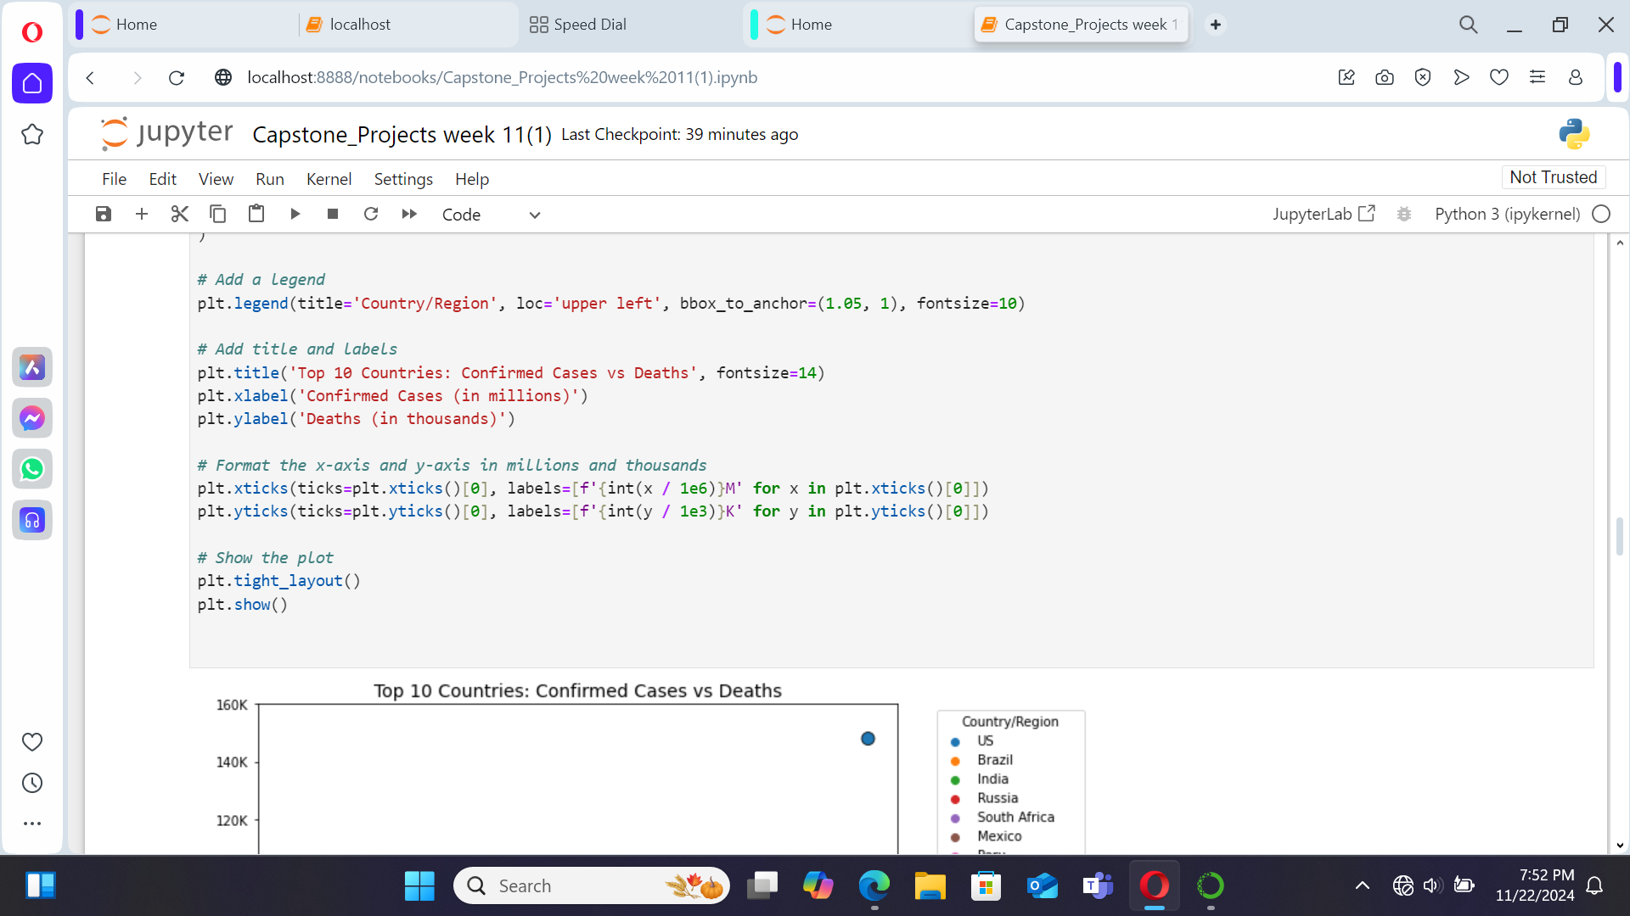

Slide 19
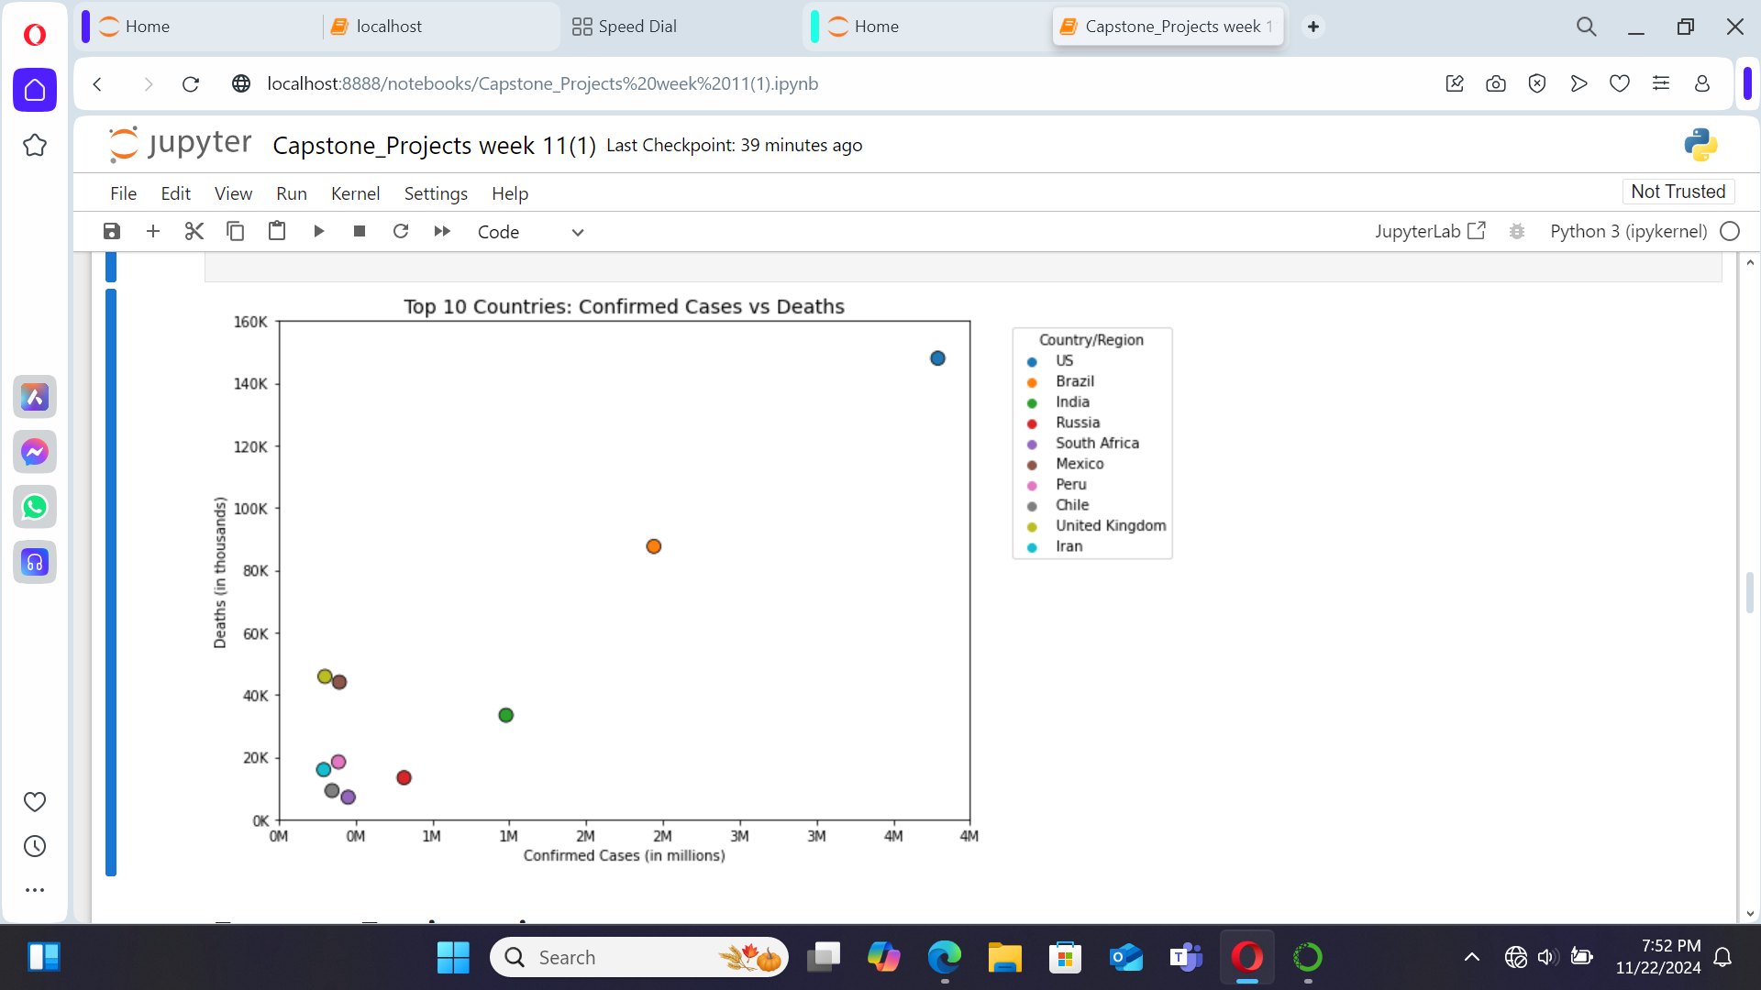

Slide 20
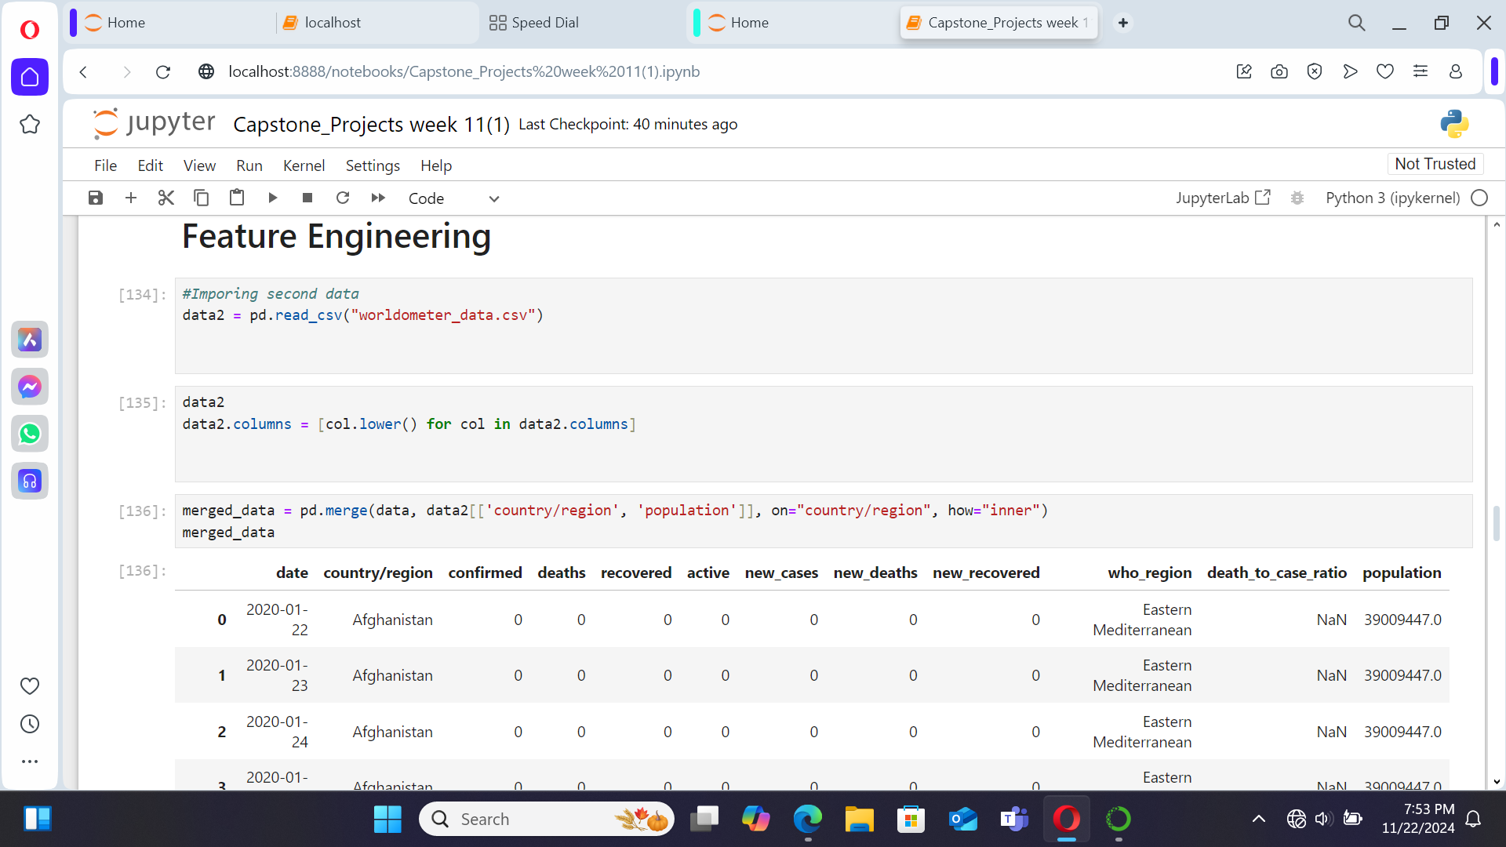

Slide 21
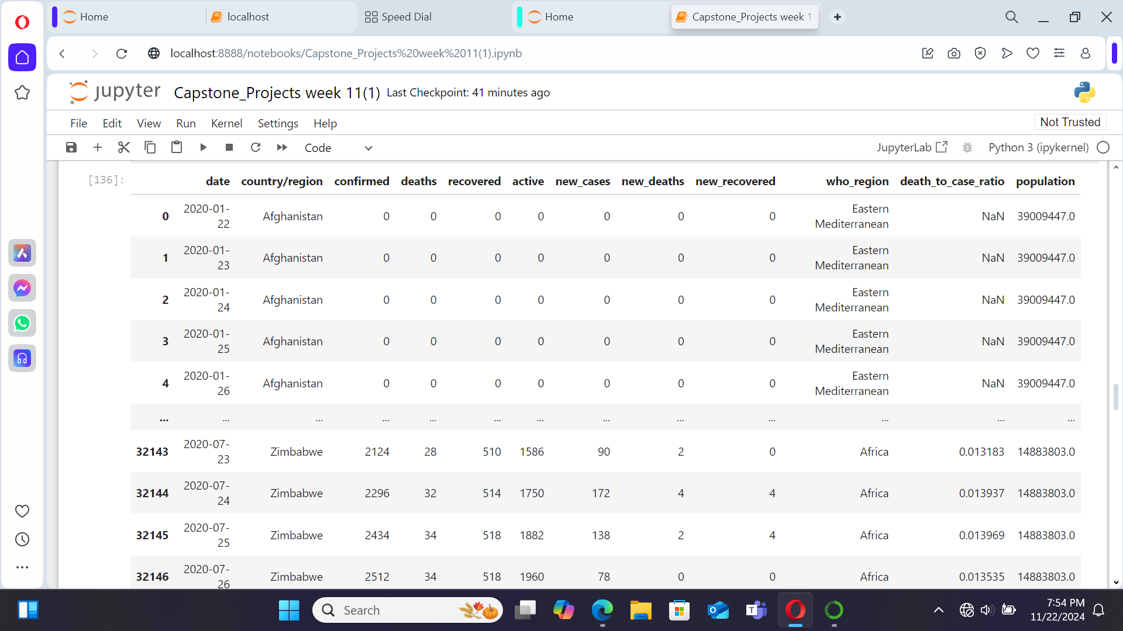

Slide 22
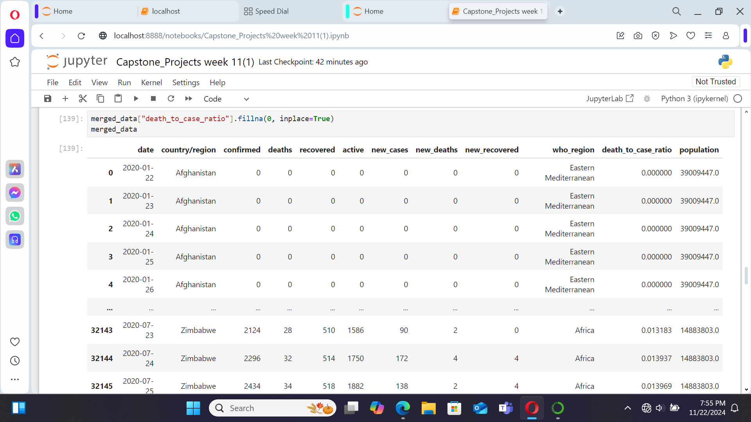

Slide 23
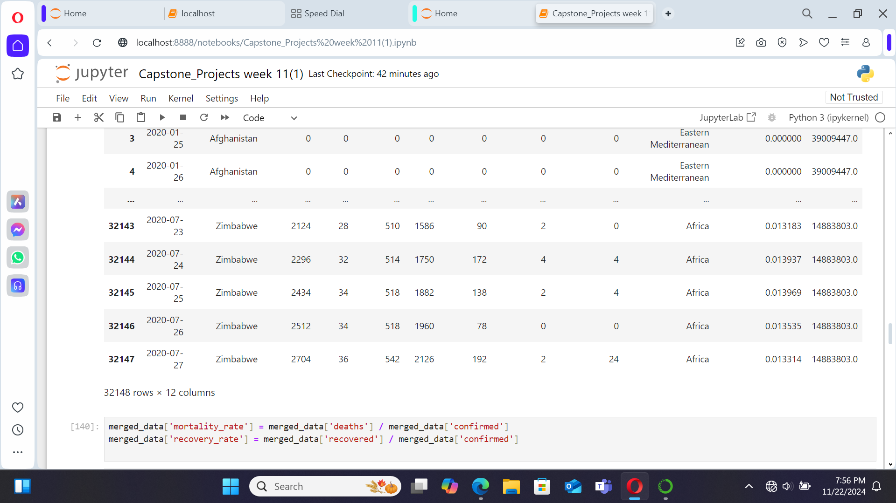

Slide 24
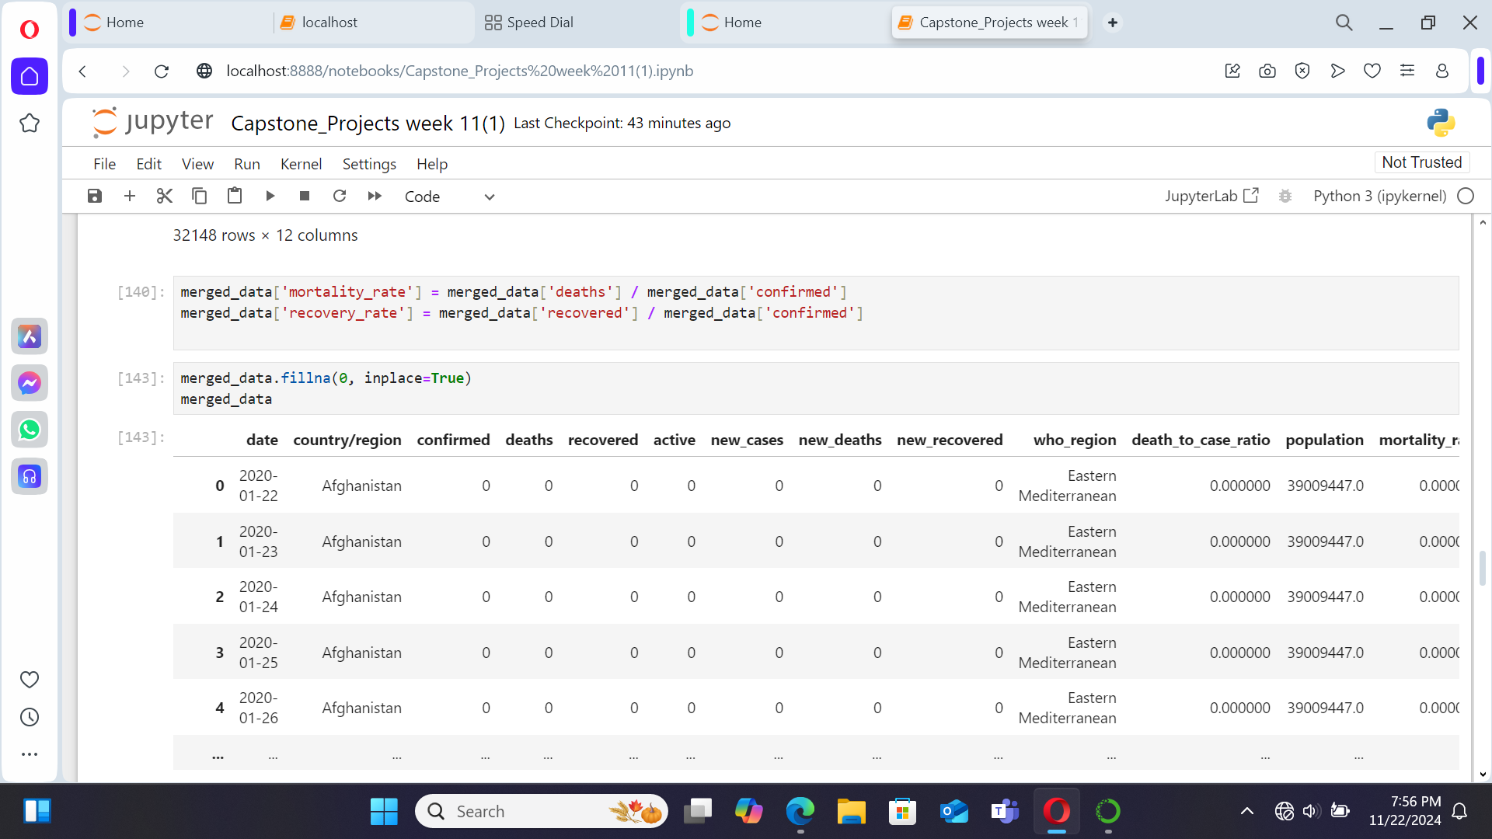

Slide 25
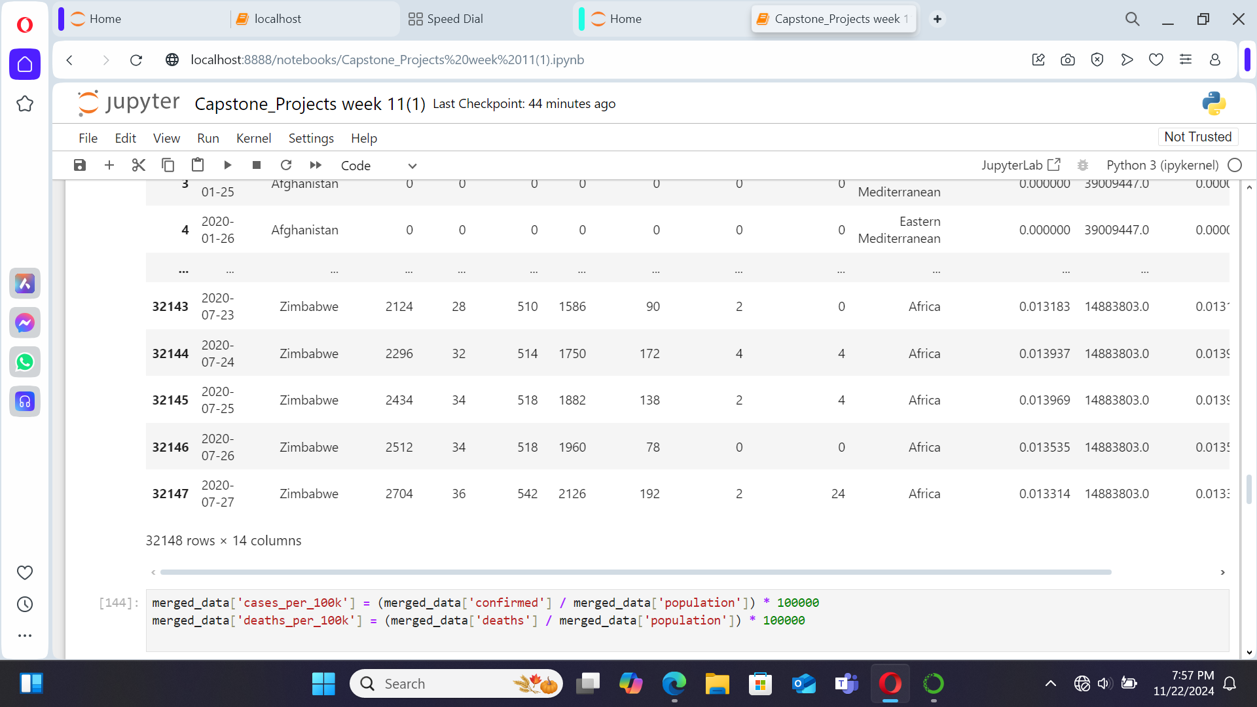

Slide 26
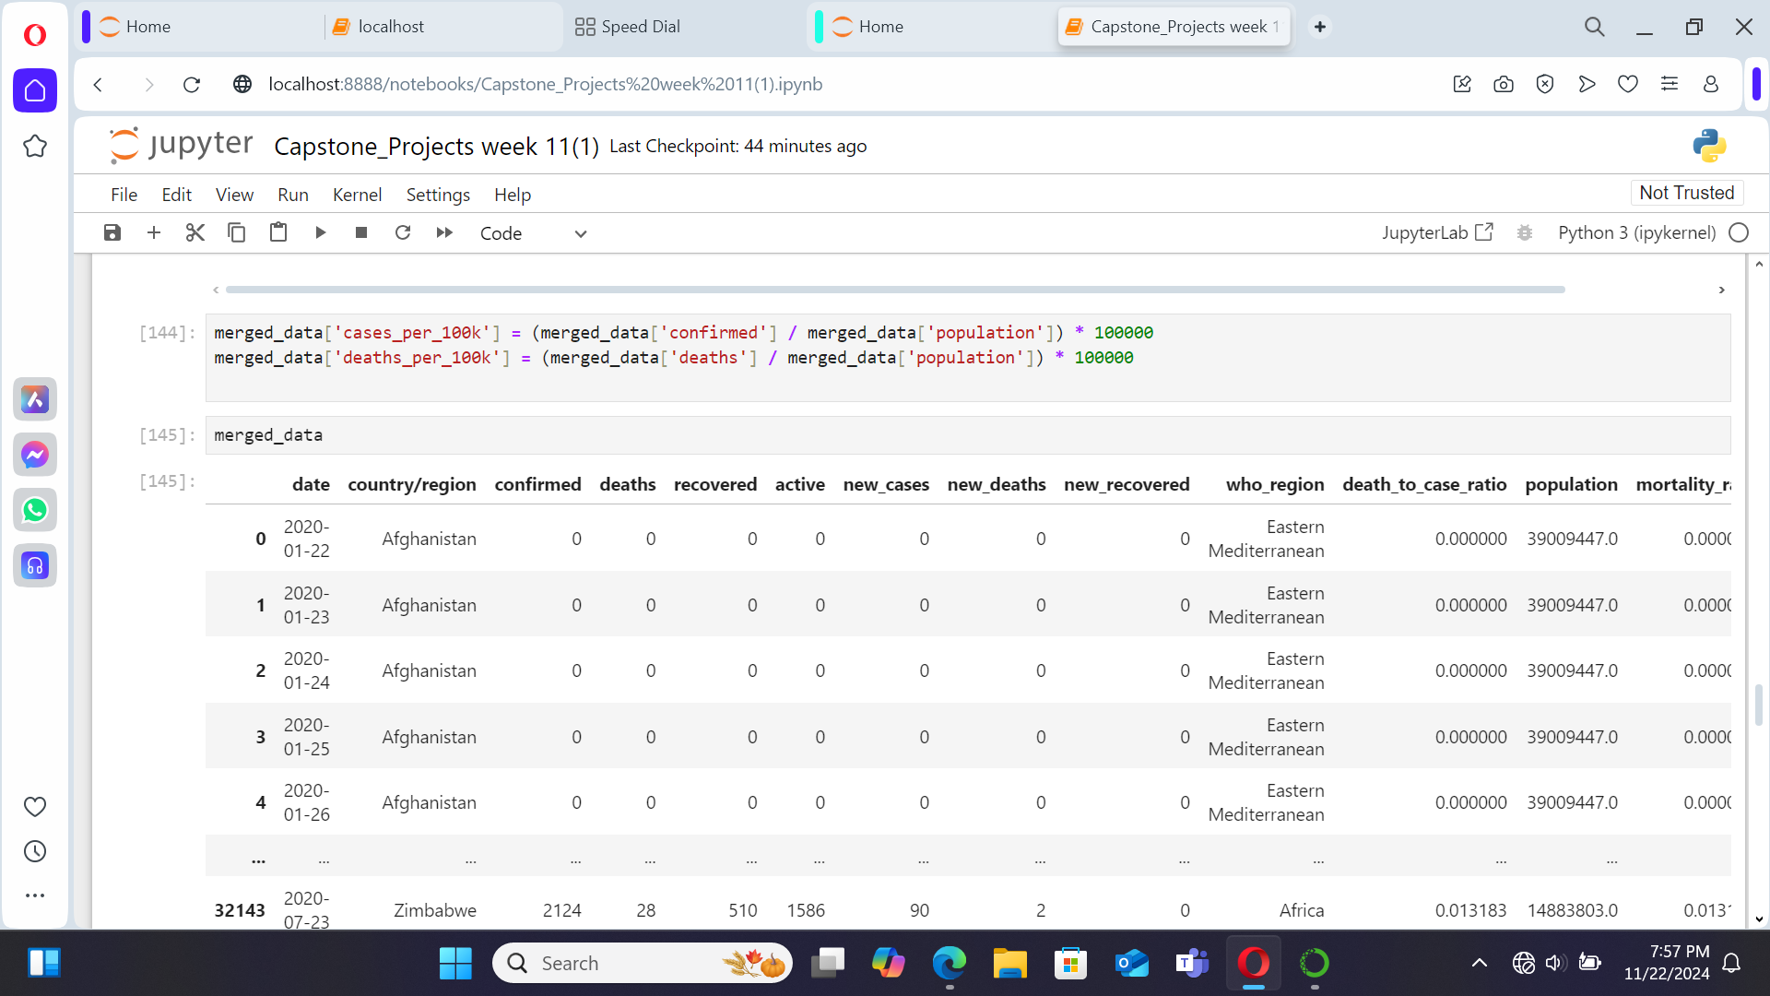

Slide 27
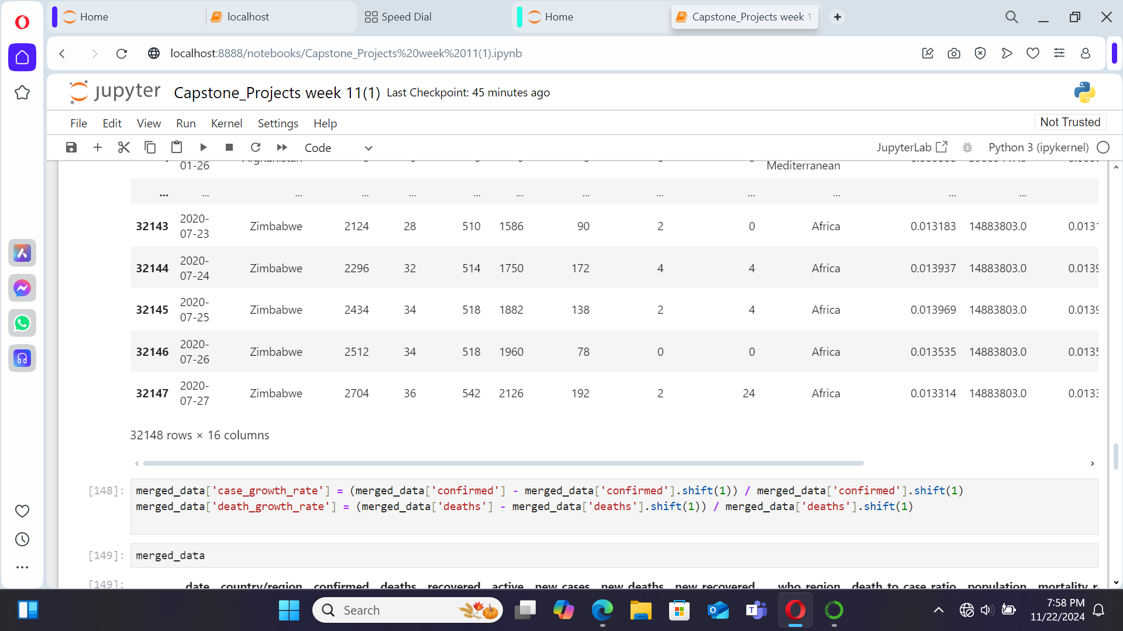

Slide 28
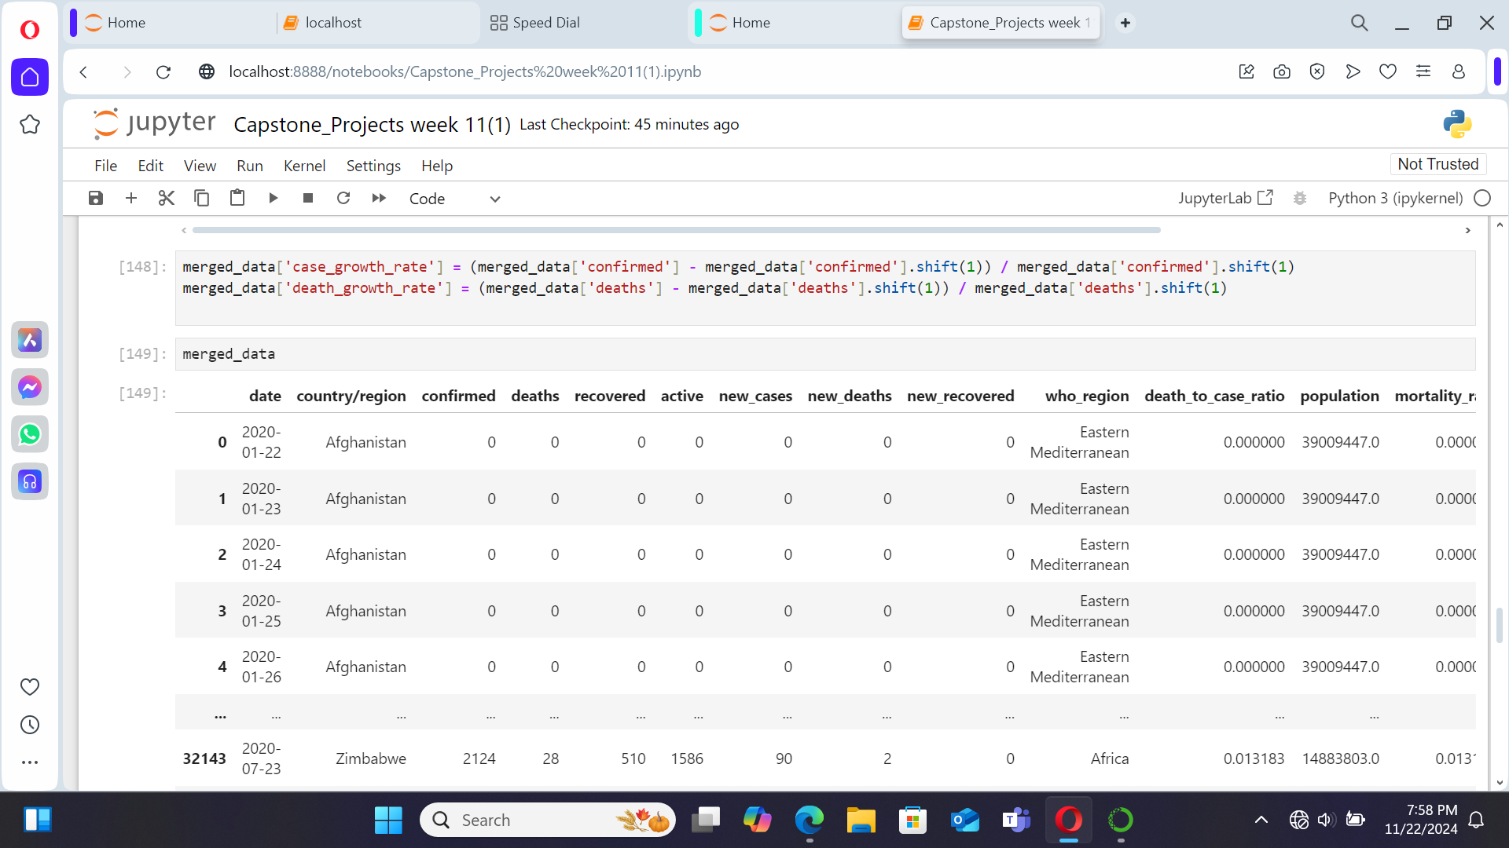

Slide 29
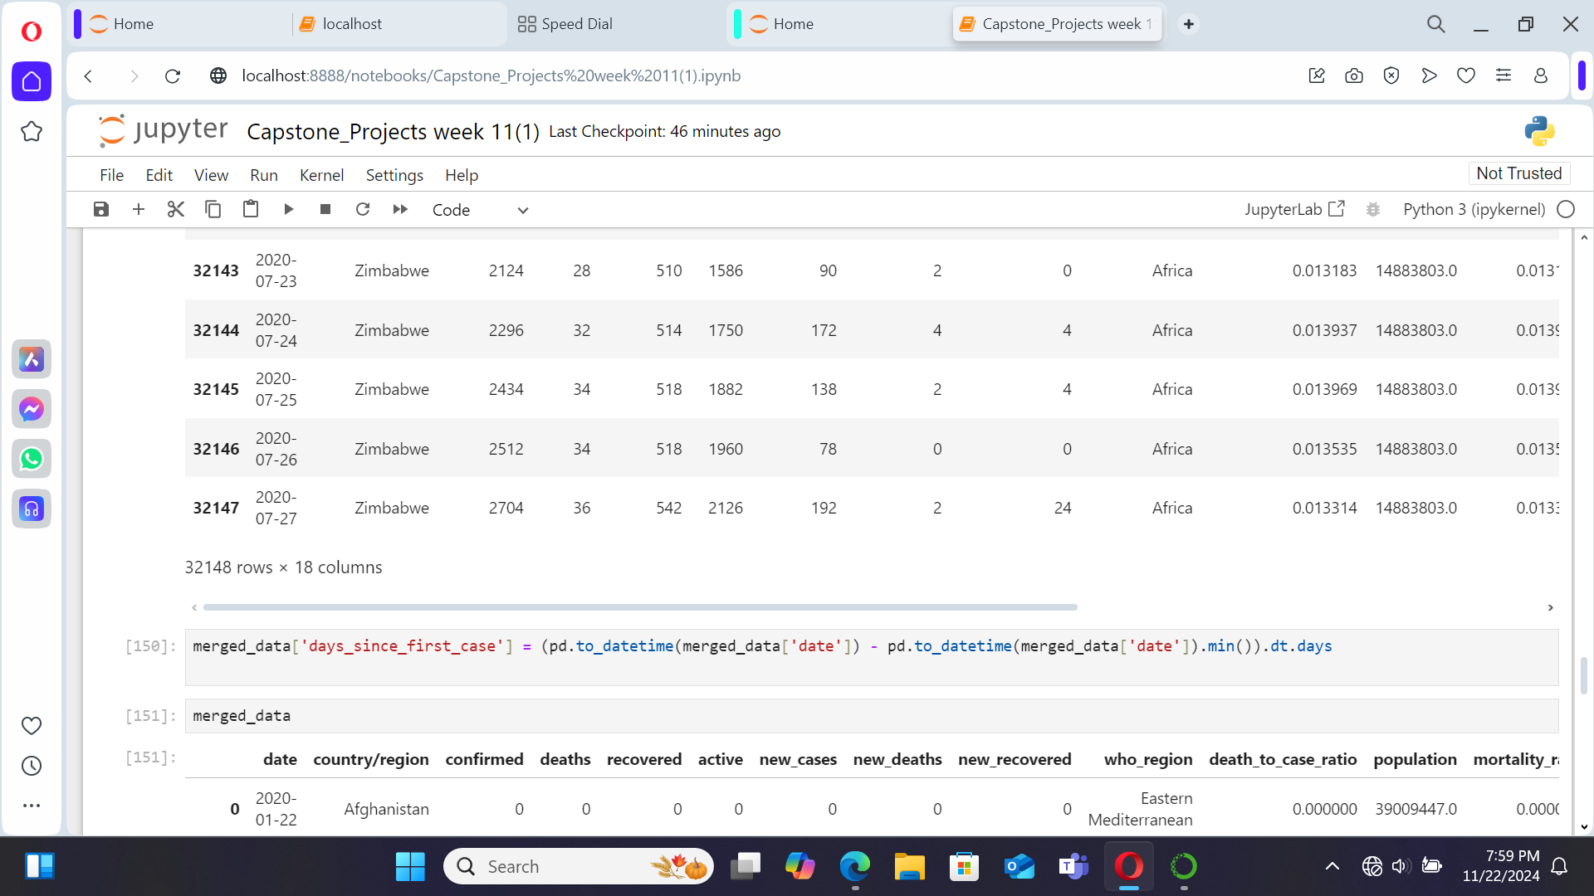

Slide 30
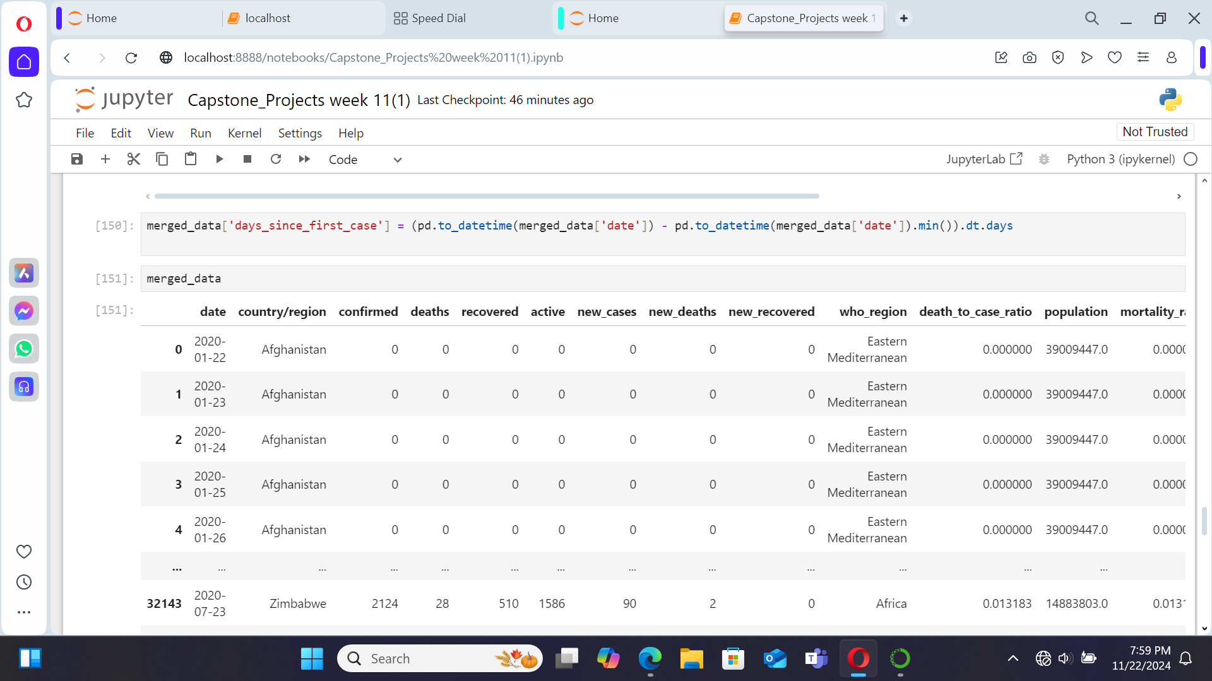

Slide 31
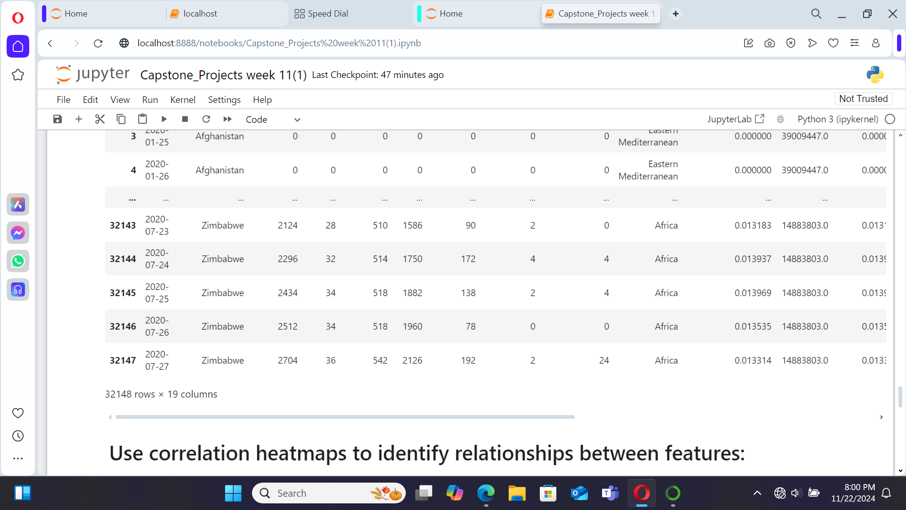

Slide 32
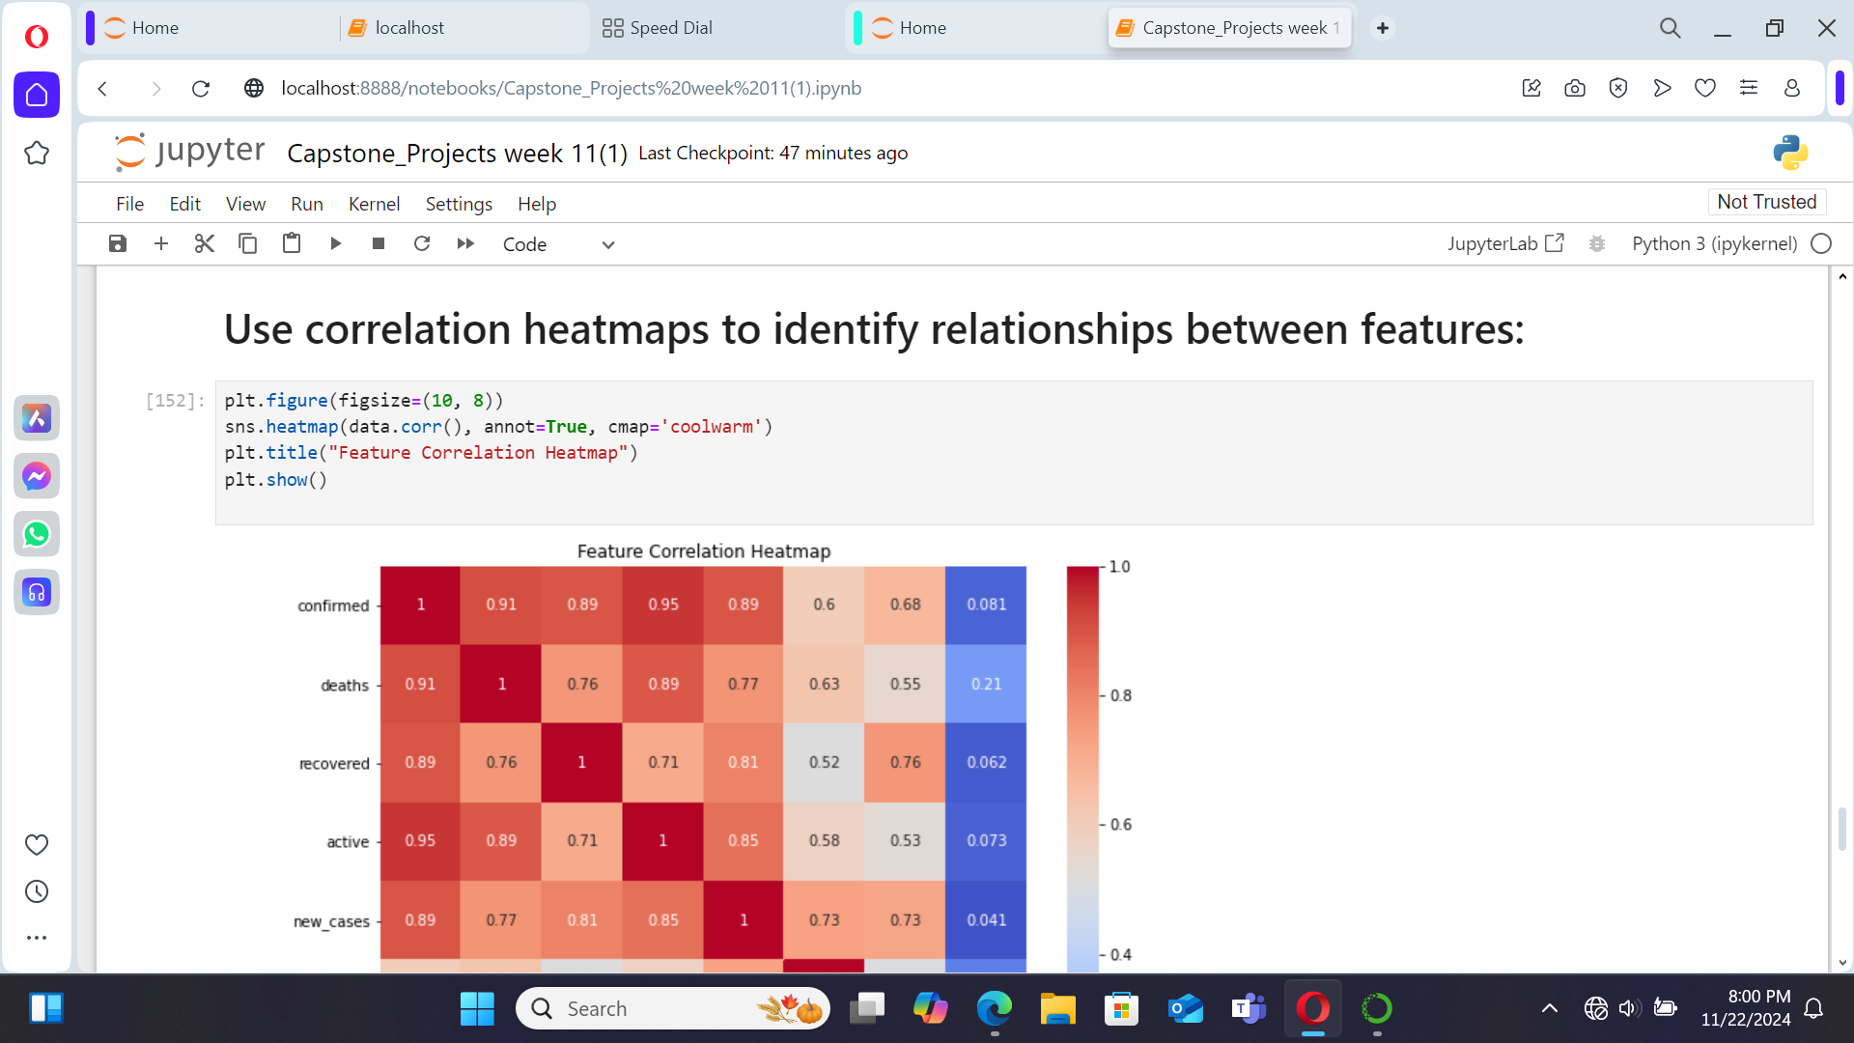

Slide 33
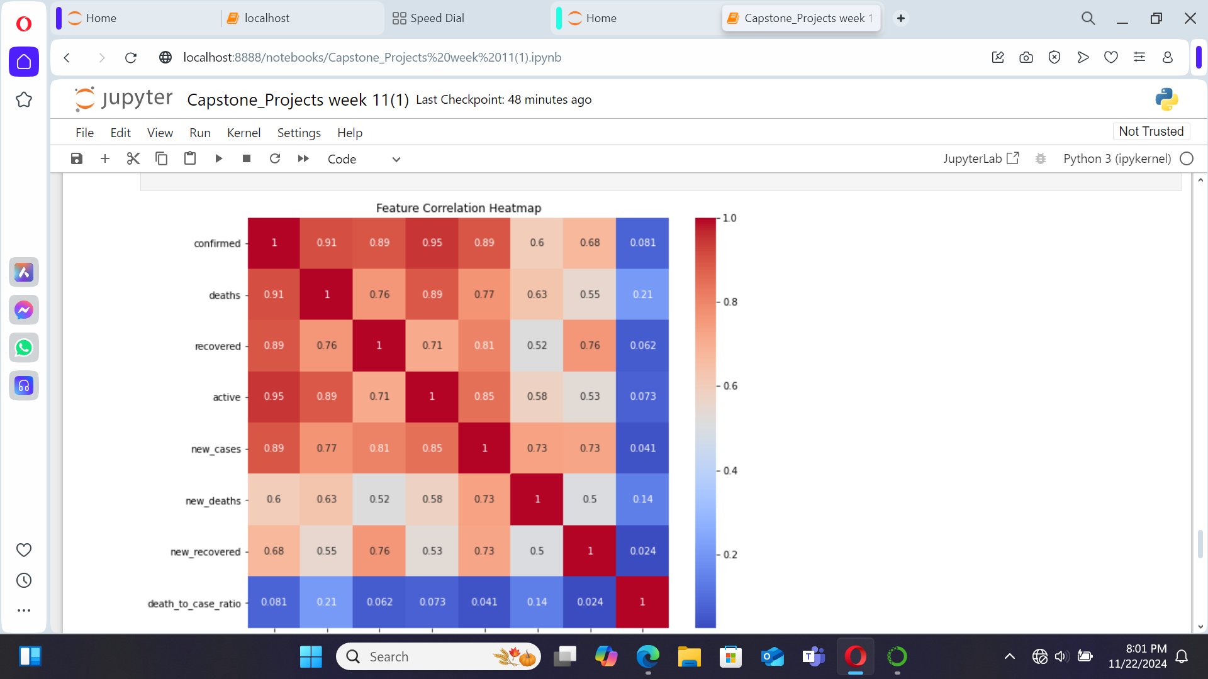

Slide 34
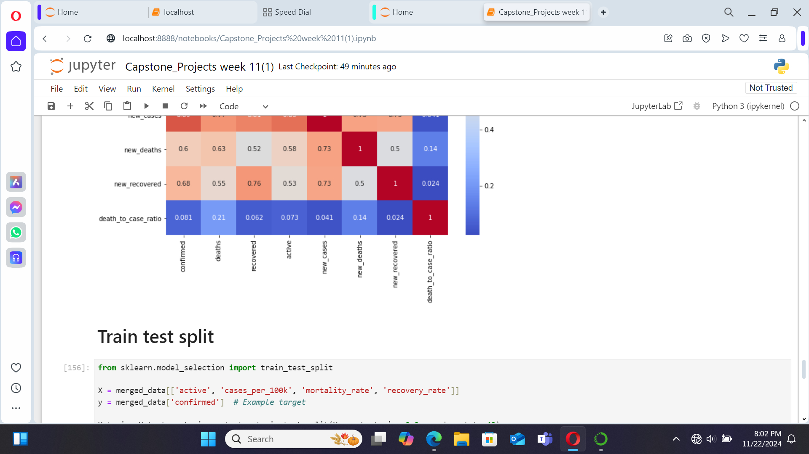

Slide 35
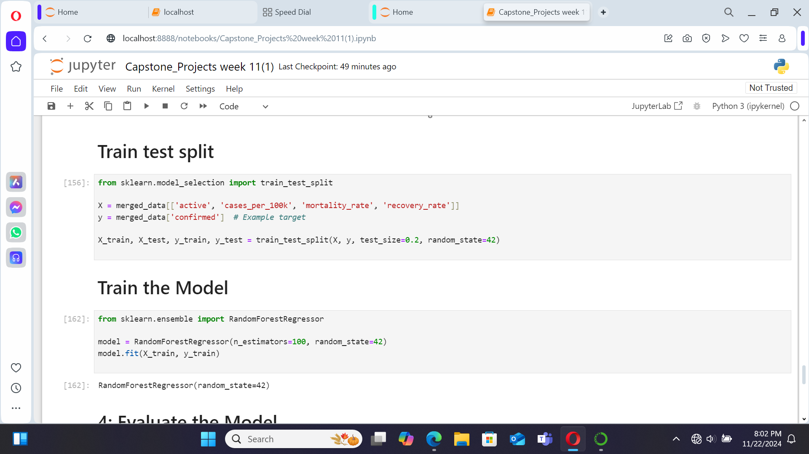

Slide 36
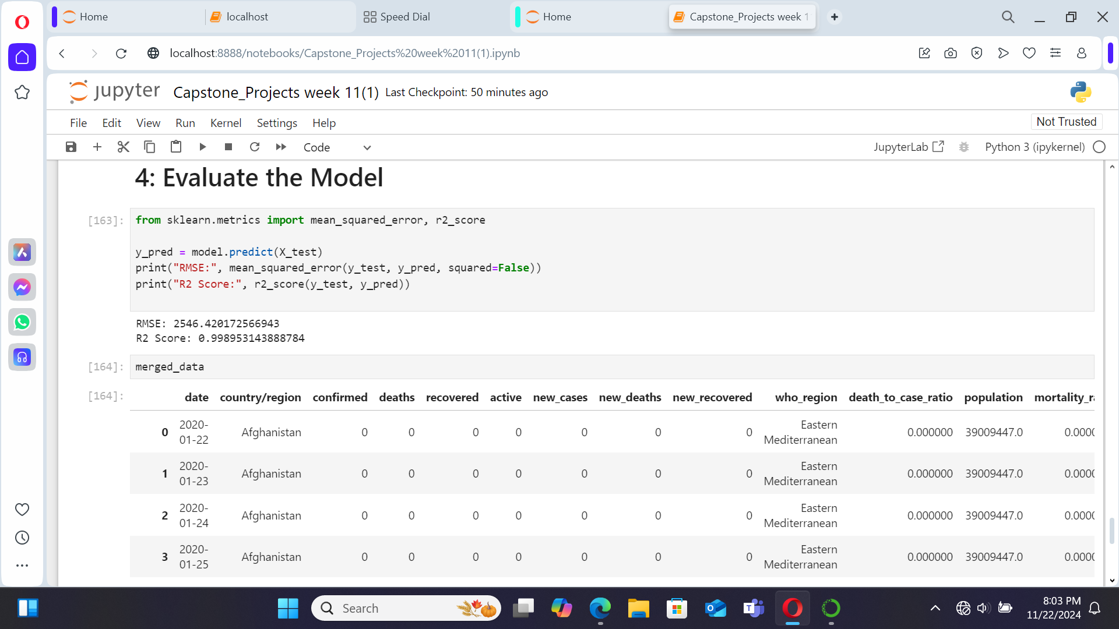

Slide 37
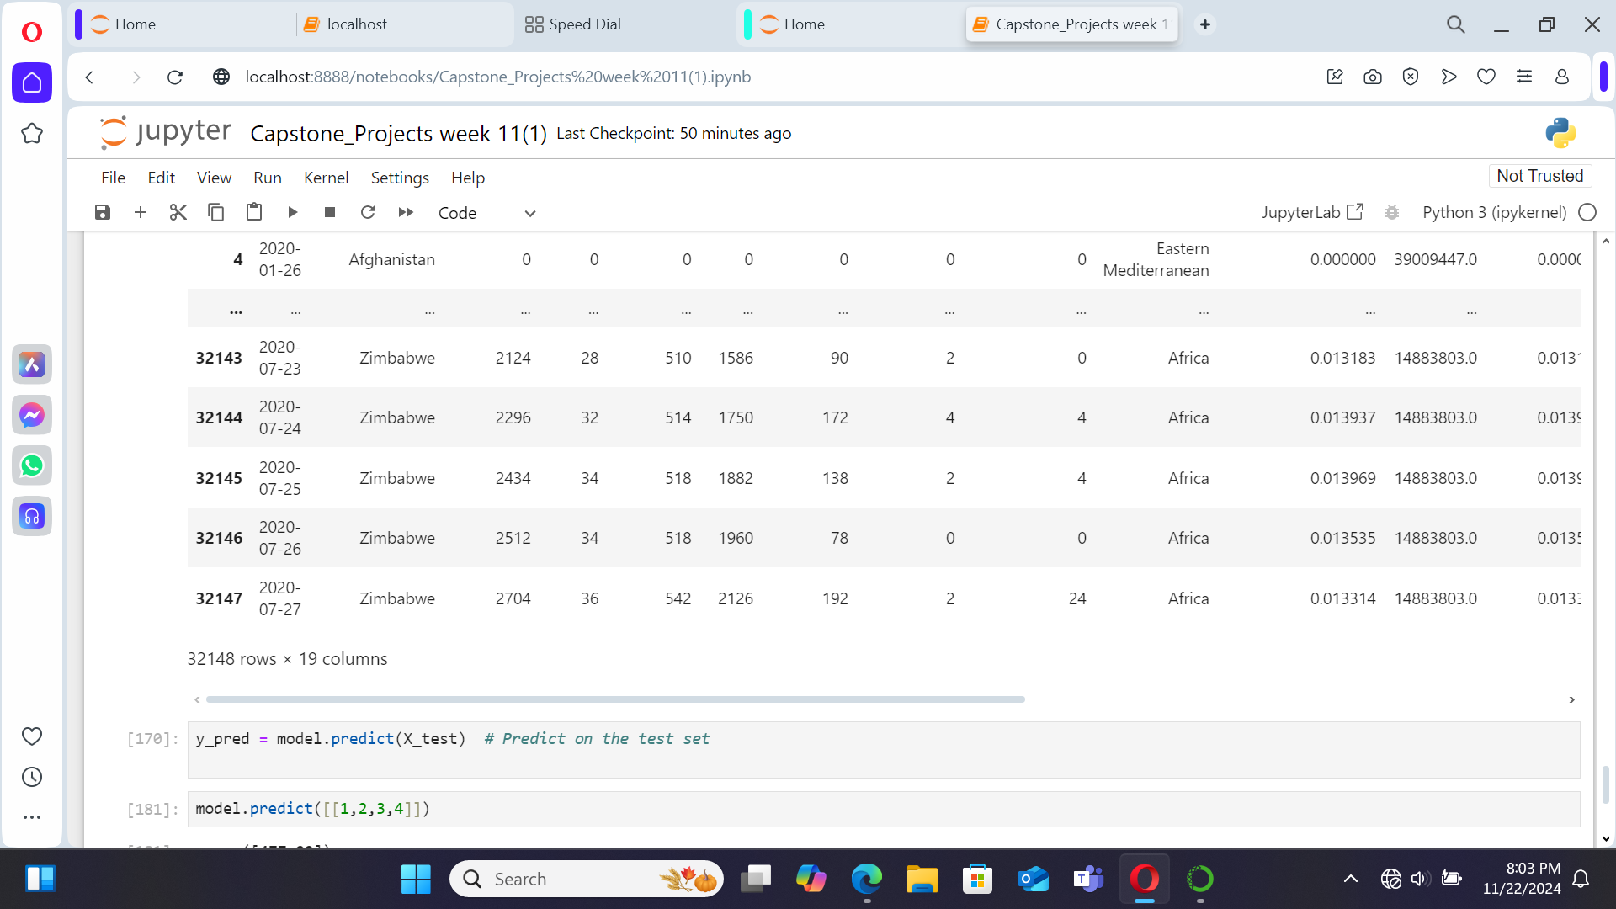

Slide 38
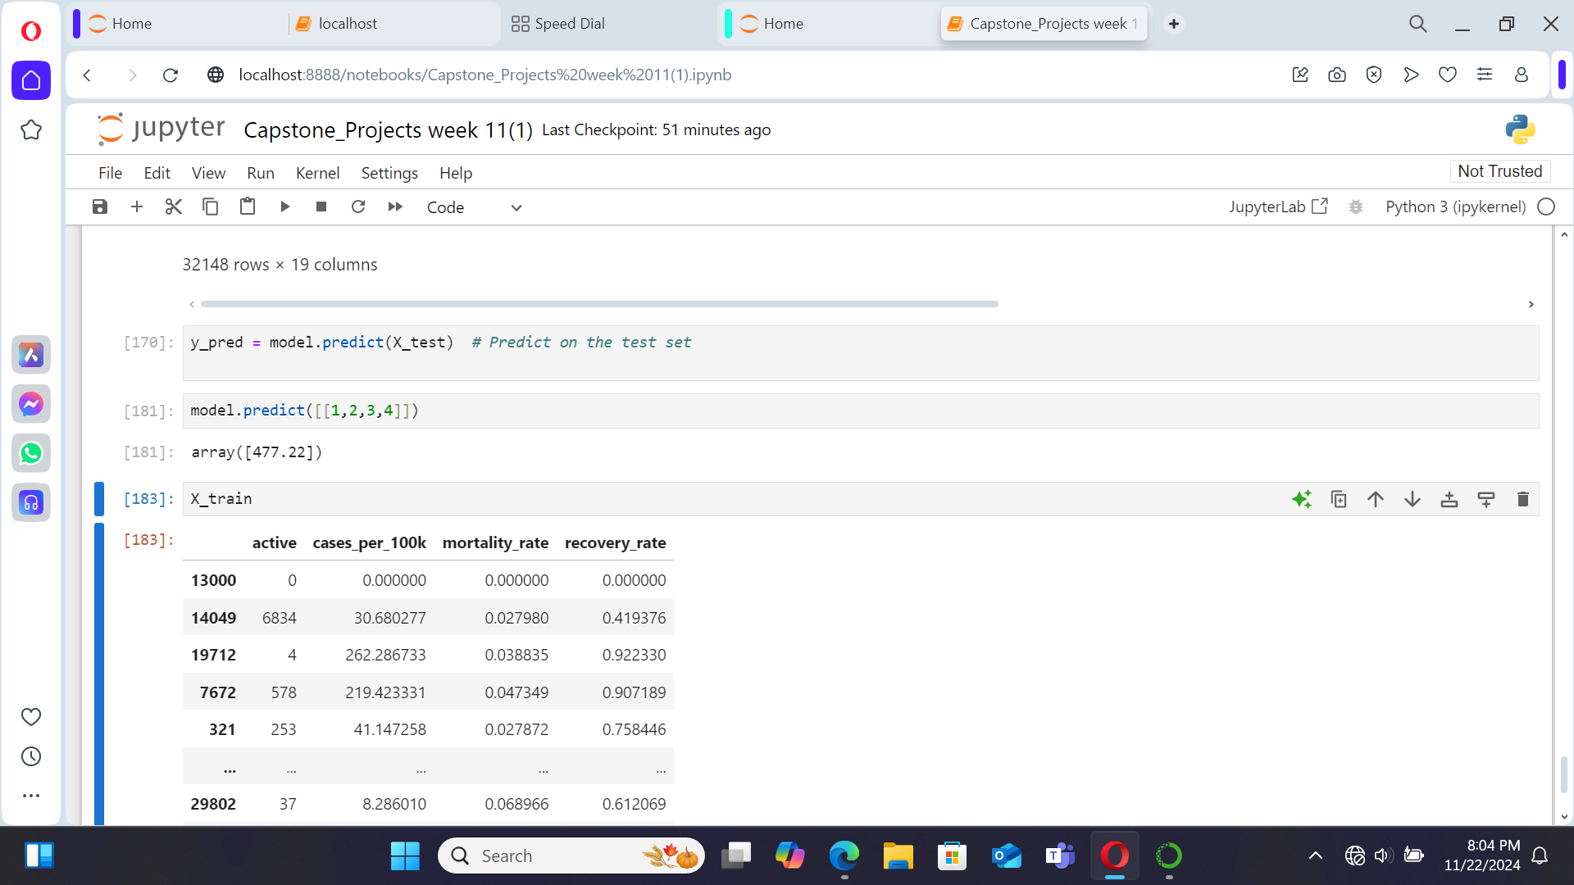

Slide 39
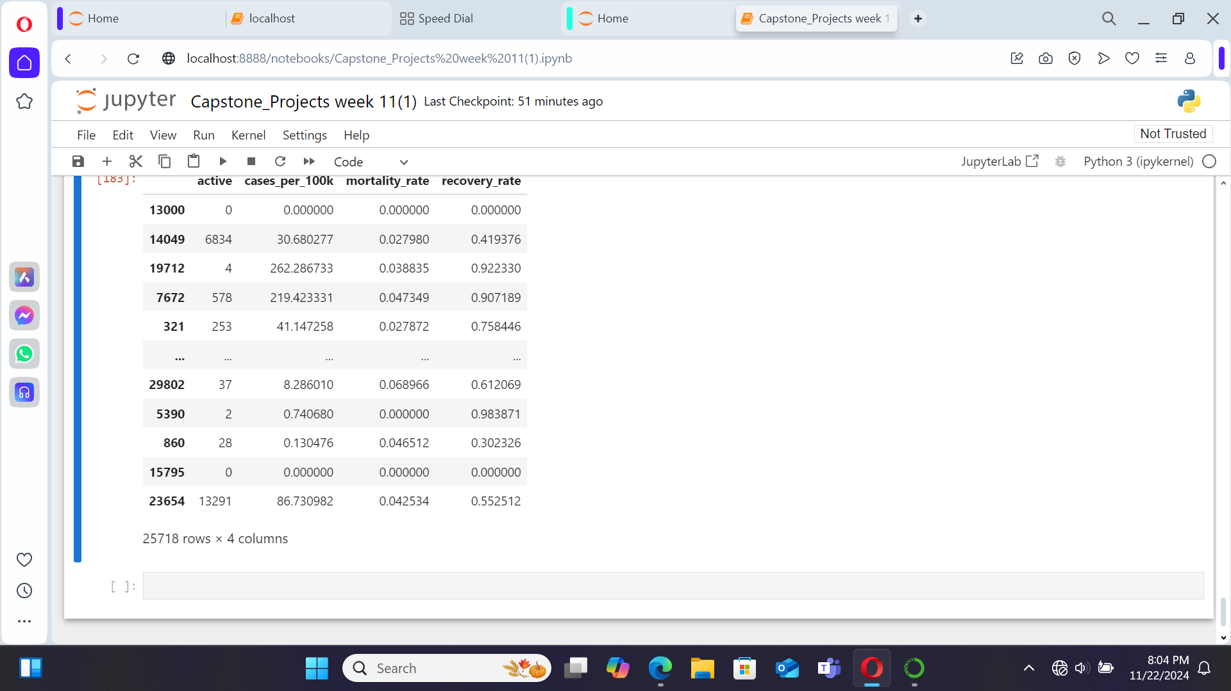

Slide 40
Technical Report: COVID-19 Analysis of Global Trends
Objective This report examines global COVID-19 trends with a focus on confirmed cases and deaths. It uses visualizations to identify patterns and highlight key findings related to the pandemic's progression.

Slide 41
Key Insights
1. Highest Confirmed Cases and Deaths
The United States (USA) leads globally in both confirmed COVID-19 cases and death counts.
2. Relationship Between Confirmed Cases and Deaths
A scatter plot reveals a direct proportionality between confirmed cases and deaths.
Observation: As the number of confirmed cases increases, the death toll rises correspondingly.

Slide 42
Top 10 Countries by Confirmed Cases
Using a bar plot, the top 10 countries with the highest confirmed cases are identified as follows:
United States
Brazil
Russia
India
Spain
United Kingdom (UK)
Italy
France
Germany
Iran

Slide 43
Top 10 Countries by Confirmed Cases vs. Deaths
A scatter plot highlights the relationship between confirmed cases and deaths among the top 10 countries with the highest combined figures:
United States
Brazil
India
Russia
South Africa
Mexico
Peru
Chile
United Kingdom
Iran

Slide 44
Visualizations
Scatter Plot: Deaths vs. Confirmed Cases
This plot demonstrates the positive correlation, emphasizing that higher confirmed case counts are associated with increased deaths.
Bar Plot: Top 10 Countries by Confirmed Cases
This bar chart ranks the top countries based on confirmed cases, highlighting the USA as the most impacted country.
Scatter Plot: Top 10 Countries (Confirmed Cases vs. Deaths)
This visualization contrasts confirmed case numbers against death tolls, showcasing variations in case fatality rates across countries.

Slide 45
Implications and Recommendations
Public Health Strategies: Nations with higher confirmed cases and deaths, such as the USA and Brazil, require strengthened interventions, including vaccination drives, public health campaigns, and robust healthcare infrastructure.
Resource Allocation: Countries with a steep rise in confirmed cases must prioritize resource distribution to reduce strain on healthcare systems.

Slide 46
Conclusion
This analysis provides a foundation for understanding COVID-19's global impact. Future research can explore factors influencing case fatality rates and the effectiveness of containment measures.

Slide 47
THANK YOU

